Slide 1
Teacher Training Workshop for Secondary Trainees
Character and
Character Education in Schools
Notes:
These slides provide an introduction to the theory and practice of character education in schools from the Jubilee Centre for Character and Virtues at the University of Birmingham.

Slide 2
The Jubilee Centre For Character and Virtues
The work of the Centre seeks to help people understand and demonstrate the benefit that good character and virtues bring to the individual and society.
Notes:
The Jubilee Centre is a research centre based at the University of Birmingham, founded in 2012. It is the largest research centre in the world dedicated to moral character and virtues. It has informed the DfE, Ofsted and policy makers, such as the Secretary of State for Education. The Centre has established a distance-learning MA in Character Education (the first and only one in the world). It employs 25 people from a range of disciplines, including psychology, education and philosophy. It conducts world-leading research and developmental work, with young people (at all school levels) and professionals. It has an international impact in over 25 countries and has worked with teachers and government ministers in these countries, as well as regional UNICEF programmes.

Slide 3
The Purpose of Education
Education should aim to form people so they can live well in a world worth living in.
Notes:
Education is more than just the inculcation of knowledge. As teachers, we have greater moral responsibility than many other professionals. Teachers can be thought of as in loco parentis (in place of the parent).

Slide 4
Aims of Education
Every child can be taught
Educational institutions cannot turn out fully educated human beings
Schooling does not complete our education
Only through the trials of life can someone be fully educated
Notes:
Education is more than just the inculcation of knowledge. As teachers, we have greater moral responsibility than many other professionals. Teachers can be thought of as in loco parentis (in place of the parent).

Slide 5
Aims of Education
Character is not a simple concept, but rather a very complex aggregate of ideas, deeds, tendencies, and habits and this aggregate varies with each individual.
Notes:
Education is more than just the inculcation of knowledge. As teachers, we have greater moral responsibility than many other professionals. Teachers can be thought of as in loco parentis (in place of the parent).

Slide 6
Aims of Education
Some say education is exclusively about academic knowledge
Others say that character in schools should simply be about telling children what is right and incentivising them to do the right thing
Both are wrong
Notes:
Education is more than just the inculcation of knowledge. As teachers, we have greater moral responsibility than many other professionals. Teachers can be thought of as in loco parentis (in place of the parent).

Slide 7
Aims of Education
Education is not about information – it is about transformation
The test is not what a student knows – they will forget that in five years – the test is who a student has become in the process of education
Notes:
Education is more than just the inculcation of knowledge. As teachers, we have greater moral responsibility than many other professionals. Teachers can be thought of as in loco parentis (in place of the parent).

Slide 8
Questions
Notes:
Remind trainees to record any questions they have throughout the workshop – to be addressed during or following the workshop (they can also be addressed in follow-up seminar sessions).

Slide 9
What is Character Education?
Character is a set of personal traits or dispositions that evoke specific emotions, inform motivation and guide conduct.
Character education is an umbrella term for all explicit and implicit educational activities that help young people develop positive personal traits called virtues.
Notes:
Virtues – the Jubilee Centre uses the language of ‘virtues’, but these are often referred to as values, traits, dispositions or character strengths within schools. The term virtue in this definition does not carry a religious association; it refers to ‘good’, ‘goodness’, what is ‘right’, ‘morality’ etc. Similarly character education is often referred to as to moral education.

Slide 10
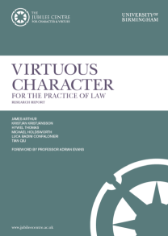
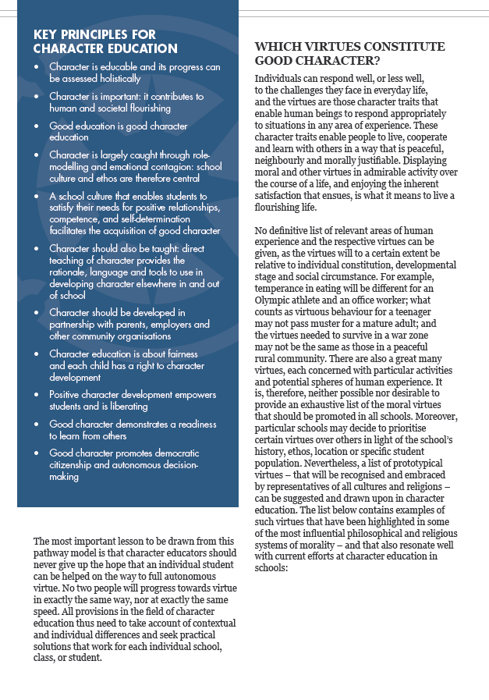
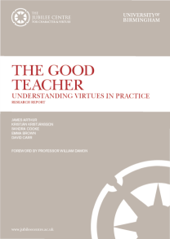
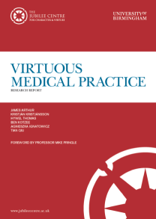
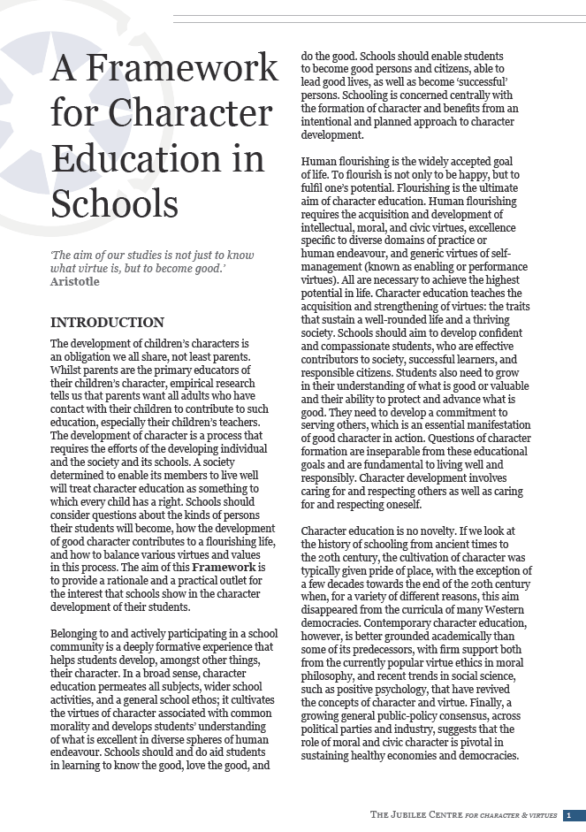
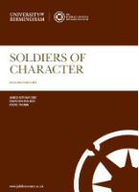
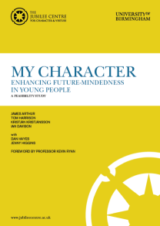
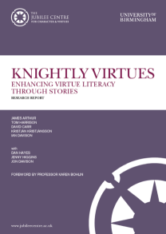
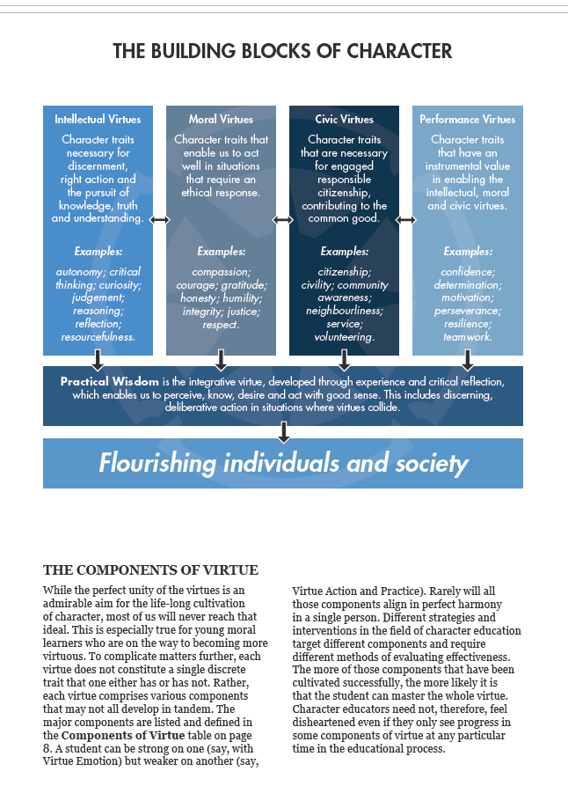
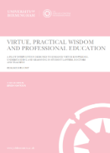
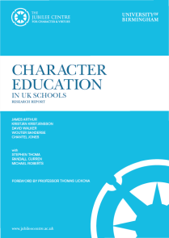
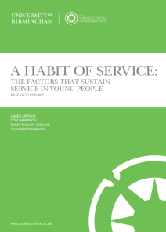
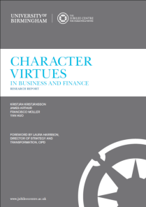
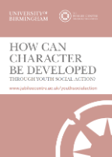
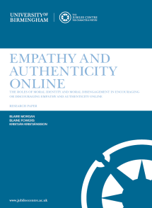
A Framework for Character Education in Schools (2017)
Centre Reports:
Notes:
The Jubilee Centre’s A Framework for Character Education in Schools (2017) follows a neo-Aristotelian approach to character education (for more information on this approach look at the further reading section) and is available to download for free on the Jubilee Centre’s website. It has been sent to every secondary school in the country and 4,500 primary schools. It explains the key principles of character education and has been adopted around the world. Research has also been conducted within the professions of nursing, business, law and the army, as well as with marginalised young people. The reports are also available to download for free on the Centre’s website.

Slide 11
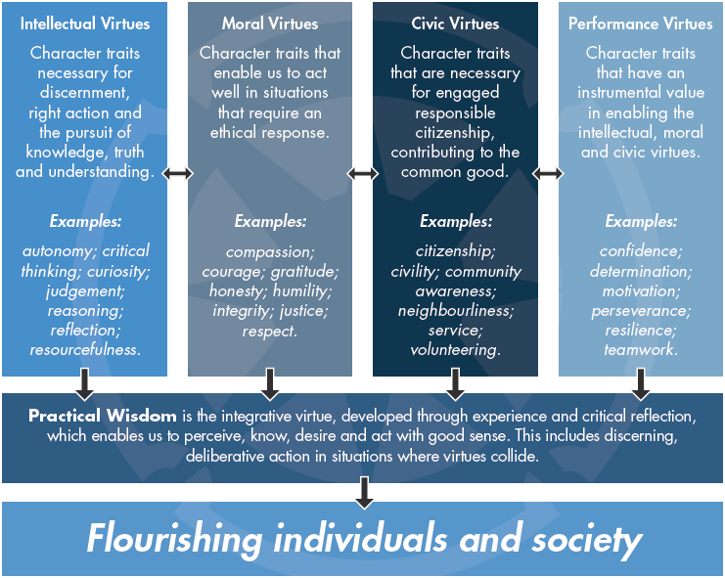
Notes:
Individuals can respond well, or less well, to the challenges they face in everyday life, and the virtues are those character traits that enable human beings to respond appropriately to a range of situations. These character traits enable people to live, cooperate and learn with others in a way that is peaceful, neighbourly and morally justifiable.
Character education teaches the acquisition and strengthening of virtues: the traits that sustain a well-rounded life and a thriving society. Human flourishing requires the acquisition and development of intellectual, moral, and civic virtues, as well as performance virtues (these make up the Building Blocks of Character).
No definitive list of virtues can be given, as the virtues will (to a certain extent) be relative to individual constitution, developmental stage and social circumstance. Although virtues can be divided up into different categories, they form a coherent, mutually supportive whole in a well-rounded life, and character education is all about their integration, guided by the overarching intellectual virtue of practical wisdom or ‘good sense’ (discussed on slide 16).

Slide 12
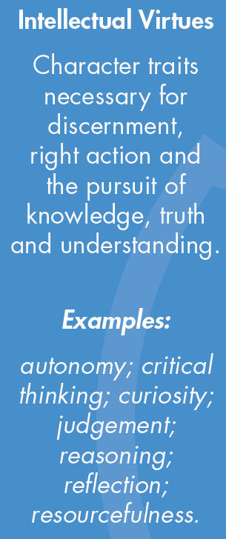
Notes:
All developing human beings will need to possess a host of intellectual virtues, such as curiosity and critical thinking, which guide their quest for knowledge and information. Among the intellectual virtues, one deserves a special mention. That is the virtue which the ancient Greeks called phronesis, which will be discussed on slide 16. It would be useful here to provide examples of intellectual virtues within the context of teaching/the classroom.

Slide 13
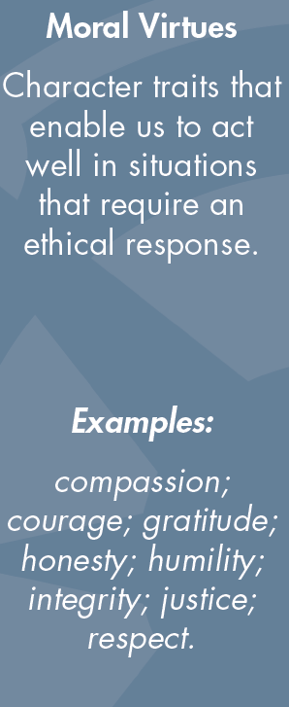
Notes:
It is not possible to provide an exhaustive list of the moral virtues that should be promoted in all schools. Moreover, schools may decide to prioritise certain virtues over others in light of the school’s history, ethos, location or specific student population. Moral virtues hold a specific role within character, whereby they have a bearing on other types of virtues, ensuring they serve morally respectable ends.

Slide 14
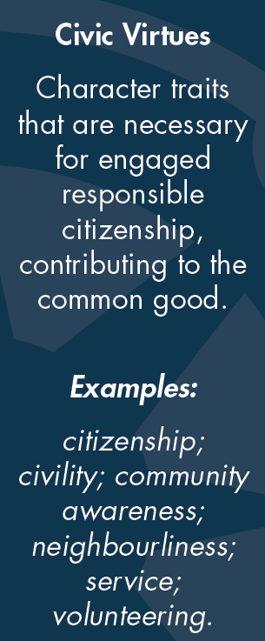
Notes:
Schools need to promote specific civic virtues, such as civility, service, citizenship, and volunteering, which help students understand their ties to society and their responsibilities within it.

Slide 15
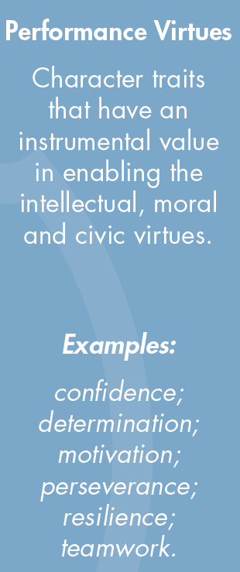
Notes:
All human beings need personal traits that enable them to manage their lives effectively. These traits are sometimes called performance virtues, or ‘enabling virtues’, to distinguish them from the specifically moral ones. All good programmes of character education will include the cultivation of performance virtues, but they will also explain to students that those virtues derive their ultimate value from serving morally acceptable ends, in particular from being enablers and vehicles of the intellectual, moral and civic virtues.
Resilience is commonly promoted in schools; however, when focused on it must be made clear that the performance virtues are ‘good’ if employed in a way that is morally ‘right’ – a gang member can show resilience, confidence or determination.

Slide 16
Phronesis
“Good sense”
Practical Wisdom is the integrative virtue, developed through experience and critical reflection, which enables us to perceive, know, desire and act with good sense. This includes discerning, deliberative action in situations where virtues collide.
Notes:
Phronesis is an intellectual virtue which can also be called practical wisdom, or ‘good sense’. It is often described to pupils as ‘good sense’ – doing the ‘right’ thing, for the ‘right’ reason, in the ‘right’ amount at the ‘right’ time. Aristotle refers to phronesis as enabling us to find the ‘golden mean’ between excess and deficiency of the virtues. It requires careful deliberation and judgement. The ability to learn from experience (and to make mistakes) is at the centre of it.
This is an important virtue for teachers when tackling ethical or moral dilemmas within in the profession (see slide 17/18). It is also important for pupils as they also face dilemmas e.g. between loyalty to friends and honesty to the teacher.

Slide 17
“Good sense” in Teaching
Can you think of any school-based scenarios where there may be a virtue conflict? (either for pupils or for teachers)
This could also be where school rules conflict with your own personal values.
Notes:
Take suggestions and discuss examples (an example dilemma is provided on the next slide).

Slide 18
Dilemma 1
You are a Year Seven Year Tutor, starting the autumn term with a new intake of pupils.
Your school has a strict uniform policy and pupils wearing incorrect uniform should be given a warning; then, if they break the rules again, sent home.
A pupil, Robert, wears dark-coloured trainers instead of the black shoes required by school rules. You know that Robert lives with his single parent father on a very low income. You have already written to Robert's father about the school's support fund to which low income parents can apply for help with buying uniform items, but the trainers remain.
School policy dictates that Robert should be sent home.
What is in conflict here?
What would you do?
Notes:
What virtues/values are in conflict here? Discuss together and take suggestions.

Slide 19
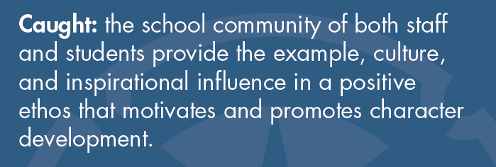
Character is…
Notes:
There is no blueprint or magic formula for delivering character education. Character ‘caught’ is the implicit side of character education. It is displayed in the school’s ethos/culture which teachers are expected to embrace. It can be seen throughout the curriculum, in all subjects and is often visible ‘outside’ the curriculum e.g. assembly, volunteering, playtime, clubs.
Character ‘caught’ also focuses on the individual teacher’s character.

Slide 20
Do you remember any of your school teachers?
Why did you want to become a teacher?
Notes:
Research has shown that adults remember their teachers because of their character; both positive and negative. This is an opportunity to provide examples of teachers from your past and why you wanted to become an educator – trainees may also wish to share their motivations.
Emphasise that teachers often enter the profession for moral reasons and motivations (for example to help children learn, to impact their lives, to ‘give something back’ and to develop good people). This links to character education because character education is about enabling children to flourish as individuals and within society.

Slide 21
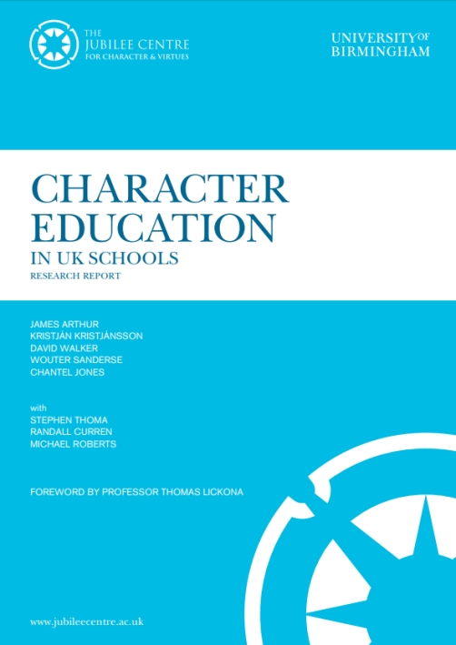
Character Education in UK Schools (2015)
84% of UK parents believe that teachers should encourage good morals and values in their students
91% of UK adults surveyed said that it is important that schools help children develop good character
Only 33% of teachers stated that they had specific or additional training in moral or character education
In secondary schools, only 35% believed that ‘teacher training had prepared them (very) well to explore and develop moral issues’ whereas 60% had to teach a subject relating explicitly to the development of the whole child
Notes:
The Jubilee Centre’s Report Character Education in UK Schools identifies teachers’ and parents’ perceptions of character education. The final statistic emphasises the need for ITE providers and schools to discuss and work on these areas with trainees.

Slide 22
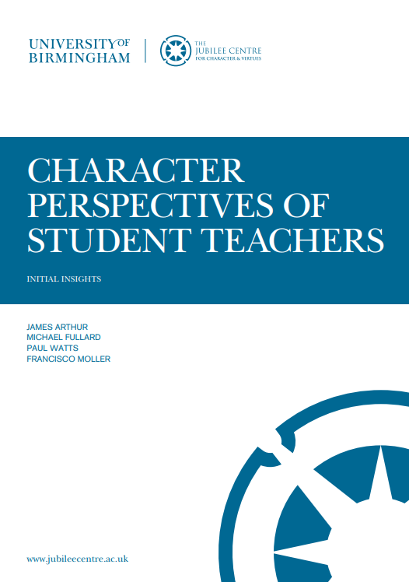
What do Trainee Teachers Think? (2018)
87% of trainee teachers acknowledged the inherent role that character plays in their own professional development
91% recognised the importance of character as a factor in the academic achievement of pupils
At the beginning of ITE, only 24% of trainee teachers felt ‘very prepared’ or ‘prepared’ to develop the character of their pupils
…This increased to 67% following ITE and training on character education
Notes:
This report is based on research conducted with trainee teachers in 2018.

Slide 23
Teachers as ‘Role Models’
Most teachers enter the profession as a result of a moral motivation such as desire to positively impact on the lives of young people
Character Education in UK Schools (2015)
99% of teachers consider themselves to be ‘a moral role model’
The Good Teacher (2015)
As teachers inevitably serve as role models within the classroom and beyond, it is reasonable to consider the character of the ‘good’ teacher and to understand what kind of person makes that kind of teacher
Notes:
These are examples illustrating the importance of character and character education within publications.

Slide 24
Teachers as ‘Role Models’
The Moral Work of Teaching: A virtue-ethics approach to teacher education (Cooke, 2017)
‘…whether teachers acknowledge their role as an exemplar or not, young people in their care will learn from their manner, behaviour, attitudes and dispositions’
Notes:
These are examples illustrating the importance of character and character education within publications.

Slide 25
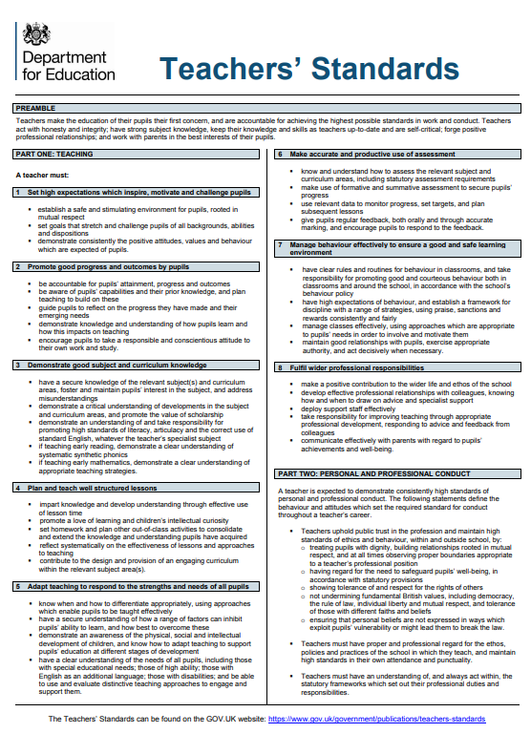
How do the Teachers’ Standards relate to character?
Preamble: ‘Teachers act with honesty and integrity’
A teacher must:
Demonstrate consistently the positive attitudes, values and behaviours which are expected of pupils.
Promote a love of learning and children’s intellectual curiosity.
Maintain good relationships with pupils, exercise appropriate authority, and act decisively when necessary.
Notes:
Teachers may be the first positive role model a pupil has. They are role models at all times – children pick up on tone, attitude, body language, eye contact etc. This slide provides a snapshot of how the character of the teacher is addressed within the Teachers’ Standards. The Teachers’ Standards require high standard of ethics – dignity, respect, tolerance; to meet these, they must set high standards, be consistent, use good sense (phronesis), and be aware of moral/ethical dilemmas that occur within teaching.

Slide 26
My Character and its Importance
Resourcefulness (intellectual) – the ability to alter a lesson based on the children’s understanding or needs
Compassion (moral) – dealing with children going through difficult situations in their home lives
Volunteering (civic) – giving up your own time to support a child to understand a concept
Resilience (performance) – seeking advice and support instead of giving up after a poor lesson observation
Notes:
These are examples of how different virtues can be demonstrated by a teacher and their importance within the profession. Other examples can be provided – this opens up a good opportunity for discussion at different stages of a trainee teacher’s training.

Slide 27
Dilemma 2
You regularly hear an experienced member of staff in your school complain about a class you both teach. You know this can be a frustrating class to teach because their behaviour is challenging.
This teacher comments that they do not bother to plan lessons properly for this class because the pupils “haven't got the brains to notice”. The teacher also comments that they see no point in marking the work that this class produces because it is 'worthless'.
What is in conflict here?
What would you do?
Notes:
Another ethical dilemma for discussion.

Slide 28
Character Education in School
What might this look like?
How and when do you think character education might feature:
Within the school day?
Within the classroom?
Outside of the classroom?
Notes:
We now turn to how character education can be ‘taught’ in school – this overlaps with how it can be ‘caught’ – the two are not mutually exclusive, but mutually supportive. How do the trainees think character can be caught/taught in the school? (besides through the teacher’s role-modelling).

Slide 29
Character is…
Notes:
There is no magic blueprint for a ‘taught’ approach. To develop knowledge and understanding we need a deliberate curriculum that supports and is supported by caught character education. This helps pupils to understand virtue terms, what they mean and what they ‘look like’ in real life. ‘Taught’ character education is planned for and deliberate. Teachers and staff are conscious of how what they teach contributes to character development. This can be inside and outside of the classroom.

Slide 30
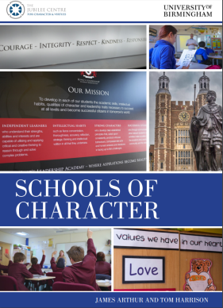
Character Education in Schools
Not just a focus on resilience or ‘grit’
Character education is integrated within the school environment and curriculum
Notes:
As will be understood from the previous slides, character education isn’t just about ‘grit’. Some schools and research publications seem to focus solely on performance virtues. Character education is about the school environment and curriculum. Indeed, many schools have particular virtues which they prioritise over others in light of the school’s history, ethos, location or specific student population.

Slide 31
Character Education in Lessons
Schools of Virtue Report (2017):
‘In developing a vision for character education schools should be aware of how each activity relating to character education will enhance the development of the components of virtue literacy…’
Children are taught about the qualities of virtuous character through standalone activities or through the incorporation of character education within subjects
Character education is a conscious part of the school day
Notes:
The Schools of Virtue report, which presents research from 3 schools in which character education is a central part of their ethos and programme of education, provides details on how schools can teach character and foster it within their curriculum, as well as within their school culture.
Character education can be part of a lesson aim/objective/outcome – it does not have to be the sole focus. Virtues can be taught about explicitly, for example in assemblies, through discussing moral dilemmas, or reflecting upon the actions of famous/historical figures. Reflection time for pupils on the virtues is extremely important, for example when discussing the actions of historical figures/events from history, pupils should be guided in reflection to consider how this is relevant to them, what lessons can be learned, how it relates to their own lives etc.
Character education is cross curricular. For example, virtues can be taught in subject lessons (e.g. perseverance when tackling new concepts in maths; compassion in science when thinking about animal testing/product development; community awareness in history; humility and honesty of characters in stories within English etc.)

Slide 32
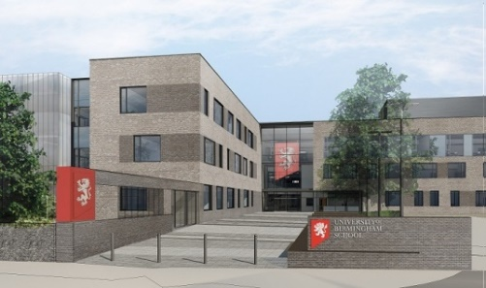
Character Education in Lessons
What might this look like?
Identifying virtues of interest at the start of lessons
Virtue definitions provided in exercise books or on display as a reference
Providing children with opportunities to reflect on how the virtues have been demonstrated in the lesson/within the taught content of the lesson
Notes:
These are examples of how character education can be explicitly ‘taught’ within lessons.

Slide 33
Virtue Literacy
The Knightly Virtues/ Virtue, Vice & Verse:
Applicable in secondary schools
Literature-based character education
The KV programme significantly increased the ability of pupils to apply virtue language and concepts in personal contexts
Notes:
The Knightly Virtues Project resources are highly popular in schools. Although they were designed for year 6 pupils, they are appropriate for year 7 and 8 pupils. The stories and activities facilitate the development of reading and writing, as well as character education. They are engaging for pupils and have been found to be popular amongst reluctant readers. This programme was designed to help teach moral character in schools using high quality classic and real-life stories. Examples of stories include: The Merchant of Venice, Don Quixote, Beowulf, Gareth and Lynette, Anne Frank etc.
The Project shows how such stories can be used for the purpose of character education. All resources are available online from the Jubilee Centre’s website. Lesson plans are easily adaptable. They include teacher notes, lesson plans and pupil resources.
The Virtue, Vice and Verse resources were designed along the same principles as the Knightly Virtues but were intended more specifically to teach about virtuous character to secondary school pupils through poetry. The project focused on different poems from a range of well-known and established poets, including Wilfred Owen, Percy Shelley, William Blake, and Emily Bronte. The resources challenge pupils to think about how the poems make them feel, and how virtues and vices are portrayed in each poem, or pair of poems. Similarly, PowerPoints, teacher guides and pupil resources are all available online from the Jubilee Centre’s website.

Slide 34
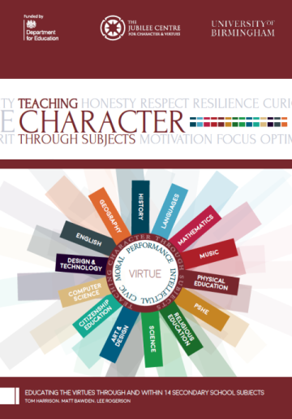
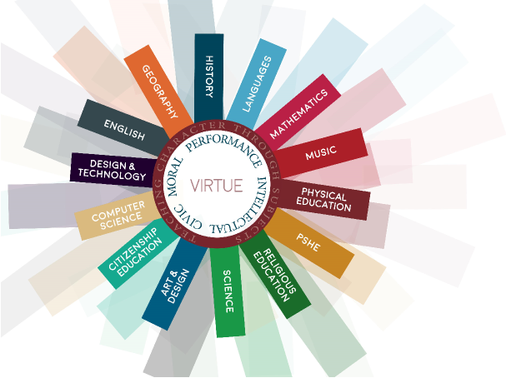
Character Education in Lessons
Teaching Character Through Subjects:
Joint project with the DfE
Examples of how character virtues can be integrated and taught within 14 secondary school subjects
Notes:
Funded by the Department for Education (DfE), the Teaching Character Through Subjects project worked with 29 teachers from 28 state funded schools to create an innovative resource for building character within 14 subjects across the secondary school curriculum. The materials were developed by teachers, for teachers, were trialed in schools and are presented as suites of resources for each subject.
Each suite provides editable examples of ways character can be taught through secondary curriculum subjects. Each suite can be adapted to fit different contexts and serves as inspiration for the development of additional materials that further explore character through subjects and the secondary school curriculum.
The materials illustrate how teachers can incorporate teaching character in different subjects/ lessons and which virtues may be best-suited to each subject. Resources and example lesson plans are available online from the Jubilee Centre’s website.

Slide 35
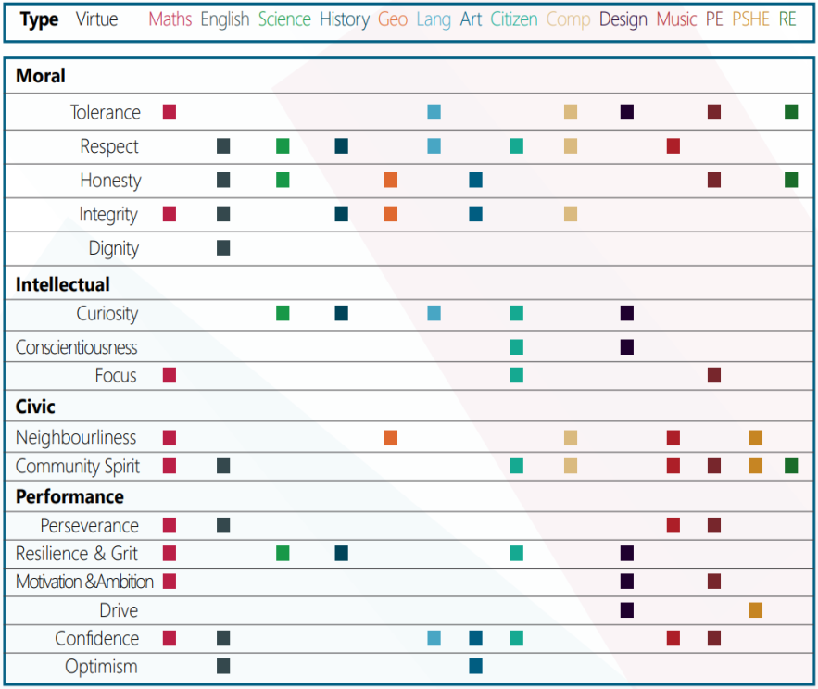
Character Education in Lessons
Shows teachers which virtues may be most applicable in these subjects
Aimed to inspire teachers to make links between their subjects and character education
Notes:
Funded by the Department for Education (DfE), the Teaching Character Through Subjects project worked with 29 teachers from 28 state funded schools to create an innovative resource for building character within 14 subjects across the secondary school curriculum. The materials were developed by teachers, for teachers, were trialed in schools and are presented as suites of resources for each subject.
Each suite provides editable examples of ways character can be taught through secondary curriculum subjects. Each suite can be adapted to fit different contexts and serves as inspiration for the development of additional materials that further explore character through subjects and the secondary school curriculum.
The materials illustrate how teachers can incorporate teaching character in different subjects/ lessons and which virtues may be best-suited to each subject. Resources and example lesson plans are available online from the Jubilee Centre’s website.

Slide 36
My Character - Journal
Focuses on 8 character virtues
Contains activities, quotes, biographies of inspirational people and actions that young people can use to help develop their character
The aim is to guide and stimulate self-reflection in young people
Notes:
The My Character resources were developed in collaboration with young people and education professionals. They encourage young people to think about who they are as well as who they want to become. Focusing on 8 character virtues, the materials contain activities, quotes, biographies of inspirational people and actions that the young people can use to help develop their character. The aim is to guide and stimulate self-reflection in young people, in the belief that this will encourage them to discuss goals, strategies, and performance and ultimately help them to become more accomplished and successful adults.

Slide 37
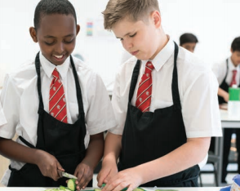
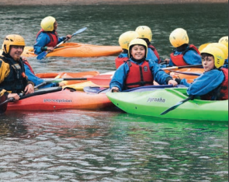
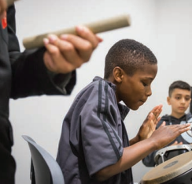
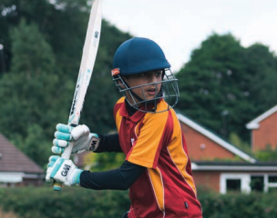
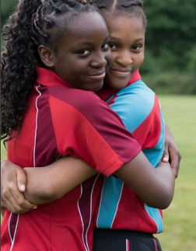
Character Education through Enrichment
Social action
Interaction with the local community
A variety of sports activities and clubs
How could you contribute to this?
Notes:
Character education occurs in and out of the classroom – it also includes extra-curricular activities/enrichment activities. Providing a safe place to practise the virtues in a new context helps to make the link between what is learnt and what is put into practice (these activities help to bridge the gap). Many schools refer to this as ‘enrichment’.
It may be useful to look at the University of Birmingham School’s Enrichment Programme and video. Reflection question for trainees – how are you/could you contribute to enrichment at your school, e.g. running clubs etc.?

Slide 38
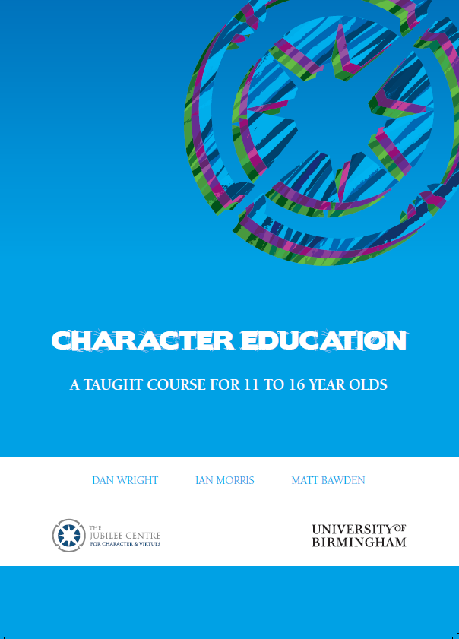
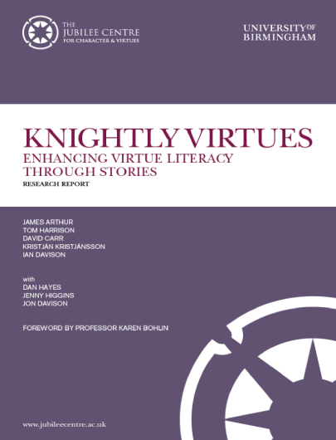
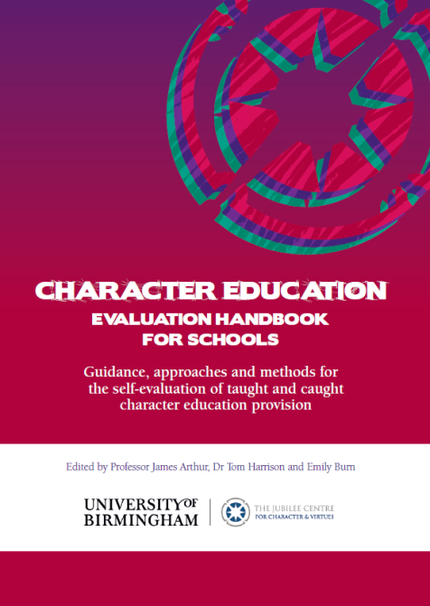
Resources
Notes:
There are a range of free resources available online via the Jubilee Centre’s website or app. The resources have been designed by teachers and experts in the field. All have been trialed in schools and have been evaluated and edited based on teacher/pupil feedback. Lesson plans, presentations and resources are provided, e.g. Virtue, Vice and Verse (teaching character and virtues through classical poetry); My Character; Teaching Character Through Subjects; Character Education: A Taught Course for 11 to 16 year olds; Gratitude and Compassion in the Classroom.
The Jubilee Centre does not aim to be prescriptive. In producing these resources, it is expected that teachers ‘dip into’ different parts and adapt these as necessary. Quite often, they are used as inspiration for teachers’ own lessons.

Slide 39
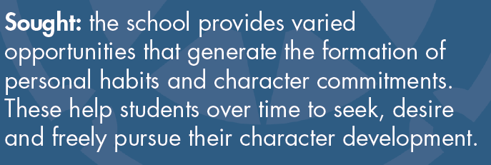
Character is…
Notes:
Finally, one of the aims of character education should be that pupils actively and autonomously seek to develop their character and virtues. This involves the provision of opportunities for pupils to actively seek to develop their own character (for example through opportunities to engage with and support the local community, the Duke of Edinburgh Award and Youth Social Action).

Slide 40
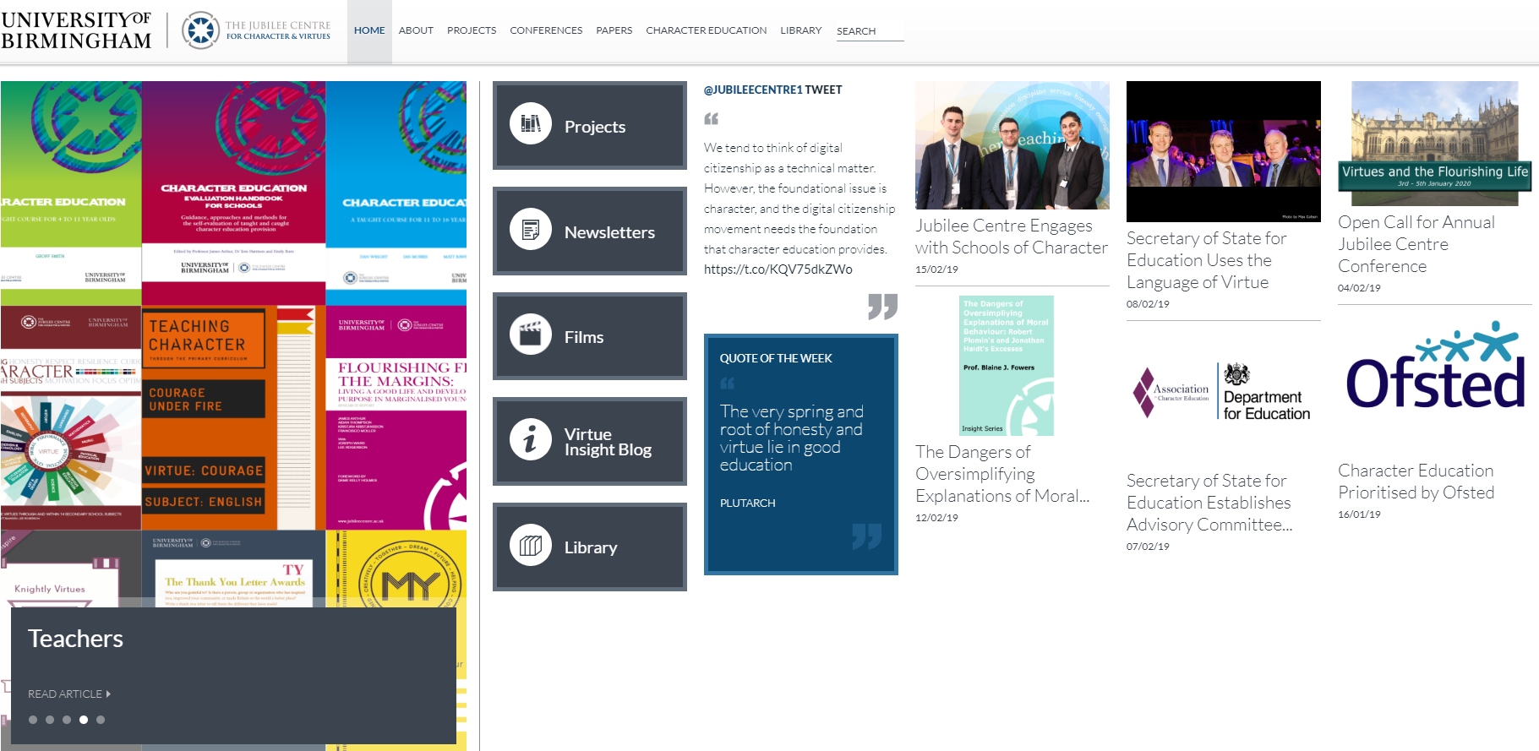
Website
Notes:
https://www.jubileecentre.ac.uk/ Through the website, trainees can access the Jubilee Centre blog and teaching resources (which are accessible via the website and free to download; hard copies of certain resources can be requested). The website contains the largest library of character/moral education texts. It also provides opportunities to get involved with research projects for individual teachers or schools. Anyone can sign up to the free monthly newsletter. Please encourage trainees to get in touch – contact details are on the website.

Slide 41
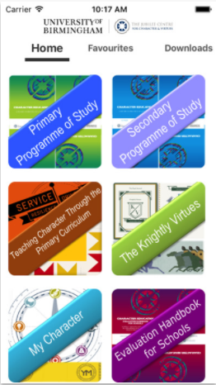
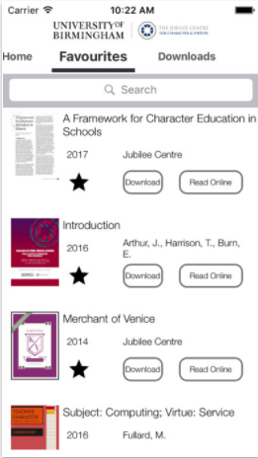
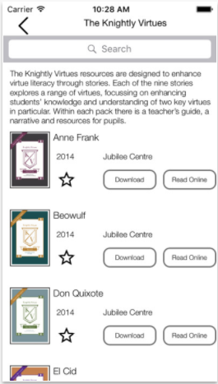
Mobile App
Notes:
The free app can be downloaded on Android and Apple via the App store. Search ‘The Jubilee Centre’ in ‘Education’.

