Slide 1
Aristotelian practical wisdom (phronesis) as the key to professional ethics in teaching
The role of phronesis (practical wisdom) in medical education and practice".
Kristján Kristjánsson
Professor of Character Education and Virtue Ethics
Jubilee Centre for Character and Virtues
School of Education, University of Birmingham
Email: k.kristjansson@bham.ac.uk
Further reading, e.g.:
Schwartz, B. & Sharpe, K. E. (2010). Practical wisdom: The right way to do the right thing. Riverhead Books.
Harðarson, A. (2019). Aristotle’s conception of practical wisdom and what it means for moral education in schools. Educational Philosophy and Theory, 51(14), 1518–1527.
Kristjánsson, K., Fowers, B., Darnell, C. & Pollard, D. (2021). Phronesis as a type of contextual integrative thinking. Review of General Psychology, 25(3), 239–257.
Kristjánsson, K. & Fowers, B. (2024). Phronesis: Retrieving practical wisdom in psychology, philosophy, and education. Oxford University Press.

Slide 2
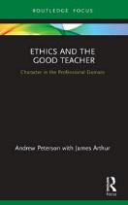
Our research with students and professionals on professional ethics
2012-14: Doctors, Lawyers, Teachers (book 2022)
2015-17: Business, Nurses, British Army
2021-22: Police
Method: 250x3 surveys, 25x3 interviews, 5 academics interviews
One part of the survey: 6 dilemmas to tease out virtue ethical reasoning vs. deontological (rule-based) vs. utilitarian or self-serving

Slide 3
Plan of today‘s lecture
Findings from our empirical research with teachers and teacher trainees
Introducing the Aristotelian construct of practical wisdom (phronesis)
Remaining problems in Aristotle-based professional ethics (for teachers)

Slide 4
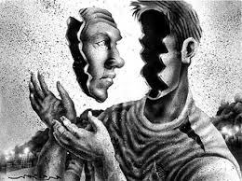
Most general finding among teachers
The respondents complained that the “moral middle” gets squeezed out – no chance to reflect upon classroom dilemmas – because the emphasis is on general principles (e.g. “inclusion”, “diversity” for teachers) or very specific rules (e.g. about teachers’ dress codes) or formal ethical codes
The respondents complained about being torn and pressured, not being able to “act out their real character” in classrooms
The teacher educators interviewed understood “character” very formalistically or instrumentally
Chimes in with Schwartz and Sharpe (2010) on ethical compliance secured through rules backed up by carrots and sticks...but does not work and is anti-professional!!!

Slide 5
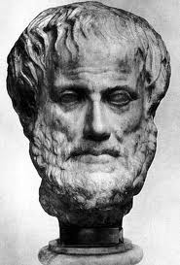
What should professional ethics in teaching be about?
According to neo-Aristotelian virtue ethics:
Development of the teacher’s phronesis: capacity to make excellent choices (not following rule-books!) in morally difficult situations, where 2 or more virtues seems to collide (e.g. honesty vs. loyalty to colleagues) in situations involving a) colleagues (e.g. whistleblowing scenarios), b) students (e.g. differential treatment of students who need special care and love from teachers) and c) parents (e.g. parental expectations clash with school expectations)
AND (this makes teacher ethics different from medical ethics, business ethics, etc.):
Also help their students develop phronesis (at least at high-school level and above)

Slide 6
Mismatch Between Professional and Personal Virtues
 | Virtue | Difference Score
1 | Judgement | 230
2 | Prudence | 230
3 | Hope | 220
4 | Self-regulation | 210
5 | Bravery | 176
6 | Leadership | 152
7 | Perspective | 143
8 | Social intelligence | 135
9 | Curiosity | 112
10 | Love of Learning | 108

Slide 7
Virtue, Consequence and Rule-based Reasoning
Notes:
This graph shows the average scores for each profession’s virtue, consequence, and rule-based reasoning across the 6 ethical dilemmas.
- Medics (doctors) reported the highest virtue-based reasoning (which was statistically significant with all professions apart from lawyers).
- Medics and nurses reported the highest rule-based reasoning compared to the other professions.
- Medics and nurses are the only professions to report statistically significant differences between their virtue and rule-based reasoning. Thus, they appear more likely to select the rules at the expense of the virtue reasons. This may be due to contextual pressures or their strict duty of care to their patients.

Slide 8
The dip across the whole sample
Table 4: Mean Scores in Character Dimensions between Different Career Stages
Cohort | Virtue-based reasoning | Deontological/ rule-based reasoning | Self-serving reasoning
Training | 0.62 | 0.63 | 0.28
Entry-level | 0.61 | 0.65 | 0.29
Established | 0.70 | 0.63 | 0.26
F (η_{p}²) | 44.50* (.01) | 2.71 (.00) | 10.81* (.01)
Note. *p <.001.
Notes:
The mean scores for each cohort in the three reasoning types are presented in Table 4, along with the results of ANCOVA. Post-hoc tests revealed that established professionals were statistically higher in reports of virtue-based reasoning compared to both trainee and entry-level professionals (p <.001; see Chart 14). In contrast, both trainee and entry-level professionals reported higher self-serving reasoning than established professionals (p < .01). Trainee and entry-level professionals were found not to differ in their reports of virtue-based or self-serving reasoning. No statistically significant differences were evident between any cohorts in deontological/rule-based reasoning.

Slide 9
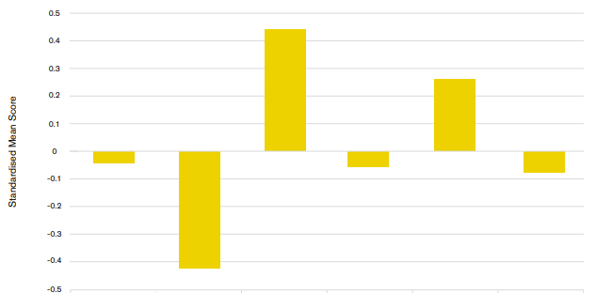
Standardised Mean Differences in Professional Purpose Across Six Professions
0.439
0.260
Police Officers
Doctors
Lawyers
Business
Teachers
Nurses
-0.042
-0.057
-0.075
-0.424
Notes:
Explain that there were many interesting findings, all of which are discussed in the report that has been published and which you’ve all already seen.
However one of the more surprising findings was that police officers scored second lowest when it came to professional purpose when compared to 5 other professions that the Jubilee Centre has done research on. And this didn’t quite align with the discussions we’d had with police officers and students, not did it really align with findings from the open question in the survey about why respondents had chosen to pursue a career in policing. For this reason we decided to subject the qualitative findings to in-depth analysis to see if we could find any explanations for this.

Slide 10
Professional Purpose
Notes:
This slide reflects differences in reported professional purpose across the four character profiles (I would use this slide for professional purpose rather than the following slide which looks across professions).
Professional purpose is referred to as a professionals’ sense of doing meaningful work that extends beyond the self and organisation to benefit a wider public good. The items measuring purpose referred to motivation, able to apply their own ideas, feeling at home at work, doing useful work, emotionally involved with work, and able to influence important decisions.
The results show that the high group reported the highest professional purpose which was statistically different from the intellectual and low groups (but not the moral). Thus, valuing both moral and intellectual virtue seems valuable to a professionals meaning for their profession. The no difference between the high and moral group suggests that valuing the moral virtues may be particularly important for professional purpose. In contrast, not valuing either virtue type appears detrimental to a sense of professional purpose.
Professional bodies should investigate ways to develop their practitioners‘ moral compass for their profession whilst also developing their practical wisdom to help them fully endorse the true purpose of what it is to be a “good” professional – especially as research has associated meaningful/ purposeful work with better job satisfaction, well-being and work engagement.

Slide 11
Basic question: What is most important method of professional ethics education for teacher trainees on an Aristotelian view?
Simple answer: Phronesis development
Does not mean that habituation and role modelling cease to play a role…
But… you will not radically transform a 1st year teacher trainee’s psycho-moral make-up if she has not already acquired a taste for virtues as ‘good habits’

Slide 12
What is Aristotelian phronesis?
Intellectual meta-virtue which guides the moral virtues
Feeding on character traits cultivated in the young through habituation, phronesis – after it comes into play (when???) – re-evaluates those traits critically, allowing them to ‘share in reason’
Core function to assess the relative weight of competing values, courses of action and emotions with respect to eudaimonia: the ultimate good and unconditional end of human beings
To adjudicate the relative weight of different virtues in conflict situations and to reach a measured verdict about what to feel and do
12

Slide 13
Domains of Virtue
Moral
Intellectual
Civic
Performance

Slide 14
Defining Phronesis
Phronesis
(4 components)
Virtue Literacy
Moral action
1) Constitutive
Ability to identify the moral problem and the perception of virtue
4) Blueprint
Knowledge/ appreciation of the good life. Reflecting moral identity
2) Adjudicative
Ability to identify conflicting virtues and to reason about the ‘right’ decision.
3) Emotional regulation
Emotional understanding (i.e., empathy or sympathy).
(Kristjánsson et al., 2021)
14

Slide 15
Observed variables
First order factor
Second order factor
Observed variables
Perspective taking-Interpersonal Reactivity Index
Moral emotion
Empathy-Interpersonal Reactivity Index
Good-Self Assessment
Moral identity
Contingencies of self-worth
Aspects of Identity
Phronesis
Moral behaviour
(pro-social)
Identification of problem
Moral sensitivity
Identification of virtues
Big 5
Situated Wise Reasoning
Justifications (ICM)
Moral adjudication
Actions (ICM)
Notes:
Stephen
Describe model
Find big 5 reference

Slide 16
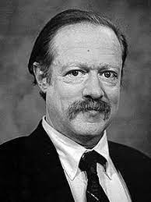
Further complication: Collective phronesis
In the Ethics Aristotle talks about phronesis solely as an intellectual virtue of an individual deliberating about dilemmas involving moral virtues. In the Politics Aristotle extends this discussion to that of phronetic rulers grappling collectively with civic virtues at the state level
Given that the ‘states’ Aristotle studied were city-states, most (apart from Athens and a few…) with less than 1000 citizens, those resembled more modern medium-sized companies or institutions such as schools and universities rather than contemporary mega-states
The father of virtue-based business ethics, Bob Solomon, fittingly compared the city-states of ancient Greece to modern firms
Given that most professional decisions nowadays are taken by teams of teachers, we need to cultivate collective phronesis also!

Slide 17
A model of phronesis for teacher trainees
Example:
You notice a misdeed by your colleague and realise there is a conflict between loyalty and honesty.
You control your strong emotions.
You think: What is my professional moral identity?
You deliberate and adjudicate.

Slide 18
Questions for discussion for teacher trainees
Which virtues or values are competing here and steering the teacher in different directions?
What are the different action options?
What are the pros and cons of each action option?
Is the teacher experiencing strong emotions prior to the decision? If so, what are those emotions?
What should the teacher do, in your view?

Slide 19
All very promising, but various PROBLEMS remain...
How do we explain this fairly complicated concept to teacher trainees?
How do we justify the blueprint-component of phronesis in our pluralist liberalist climate that is sceptical of any comprehensive doctrine of the good (Aristotelian, Confucian, liberal, socialist, etc.)?
How do we craft systematic interventions (professional education and CPD courses) to cultivate phronesis?
How do we measure the effectiveness of those interventions beyond self-reports or short-term changes in measured behaviour?

Slide 20
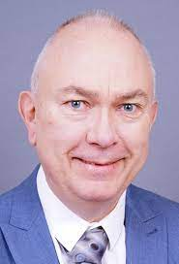
Problems II
Atli Harðarson (2019) wonders whether it is fair to expose teacher trainees to the ideal of phronesis in teacher training if they are then prevented from using this mode of thinking when they enter the workplace because the workplace is full of rules and regulations and does not allow individual teachers to take important decisions
Harðarson, A. (2019). Aristotle’s conception of practical wisdom and what it means for moral education in schools. Educational Philosophy and Theory, 51(14), 1518–1527.

Slide 21
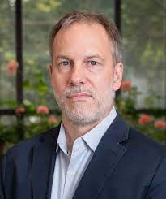
Problems III
Recent empirical literature is full of examples, from all over the world, of how badly teachers deem themselves prepared for tackling life’s biggest questions in the classroom. They complain about lack of attention to normative issues in teacher training, and about their own lack of moral language and moral identity
As Chris Higgins correctly observes, ‘restoring to its central place the flourishing of the practitioner is the first step in constructing a virtue ethics of teaching’
Before teachers can help students answer adequately the question of what kind of persons they want to become, in order to fulfil their potential, the teachers themselves need more extensive training in how to ask and answer such questions about themselves, both at the professional and personal levels
Higgins, C. (2011). The good life of teaching: An ethics of professional practice. Oxford: Wiley-Blackwell.

Slide 22
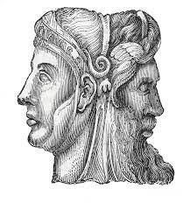
Conclusion
Becoming a practically wise (phronetic) teacher is not easy!
More difficult than for many other professions because the task is Janus-faced (see picture), both about my phronesis as a teacher and helping my students to develop phronesis also
Very difficult also because of schools are becoming more bureaucratic and rule-based and leave less space for the professionalism of the individual teacher
Too much paperwork, too little time for reflection and critical thinking!

Slide 23
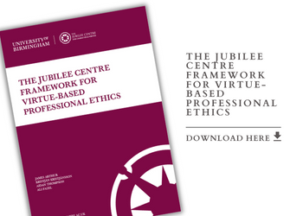
Latest materials on virtue-based professional ethics from the Jubilee Centre
Framework for Virtue-Based Professional Ethics:
https://www.jubileecentre.ac.uk/userfiles/jubileecentre/pdf/Framework_Virtue_Based_Prof_Ethics.pdf
Free online course on virtue-based professional ethics:
https://www.jubileecentre.ac.uk/media/news/article/6993/centre-launches-cpd-course-practical-wisdom-in-professional-practice
New shorter, validated phronesis instrument (<20 min.)
https://www.jubileecentre.ac.uk/userfiles/jubileecentre/images/newsletter-thumbs/2023/September/Phronesis_DevelopingAndValidatingAShortMeasureOfPracticalWisdom%20_Final.pdf

