Slide 1
Why volunteer?

Slide 2
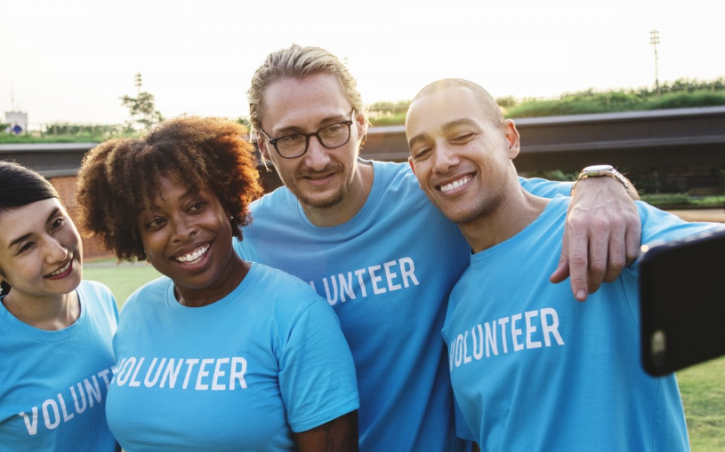
There are many organisations in your community that are staffed, led and run by volunteers. Can you think of any?
What roles do volunteers play in the organisations you’ve mentioned?
What does the organization do? In what way does it benefit the local community?

Slide 3
What is volunteering?
Come up with a definition of volunteering in a pair.
Feedback from definitions and discuss.
Are you involved in any activities like this in your school or community?
Where do people in your community already volunteer?
Do you know anybody involved in this work?

Slide 4
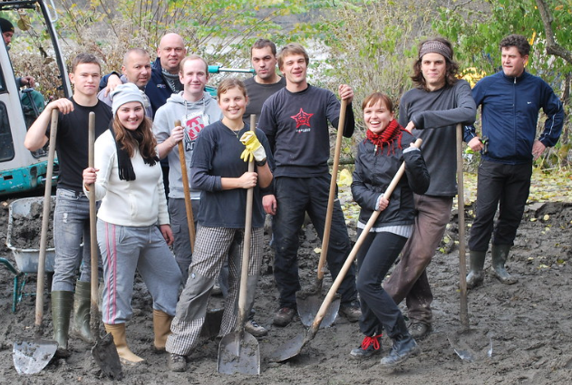
Write a short reflection on someone you know who volunteers explaining who they volunteer for and their motivation behind volunteering for that organisation.

Slide 5
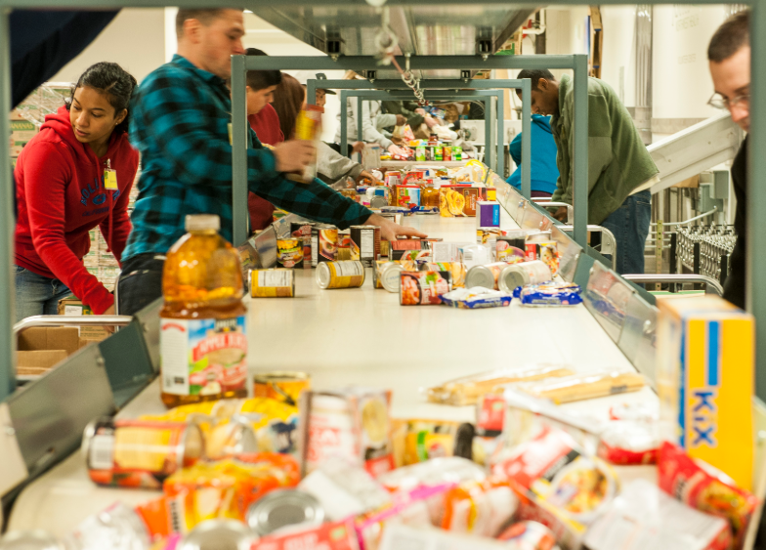
What virtues do you think a volunteer would need in the different organisations you have mentioned? Why?
What virtues might being a volunteer develop? How?
In what other ways might your character develop through volunteering?
What might people’s motivation be for volunteering? Are motives always good/virtuous?
What might be the consequences of people volunteering with negative motives?

Slide 6
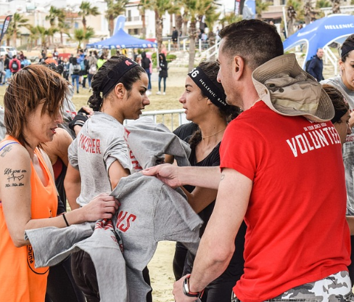
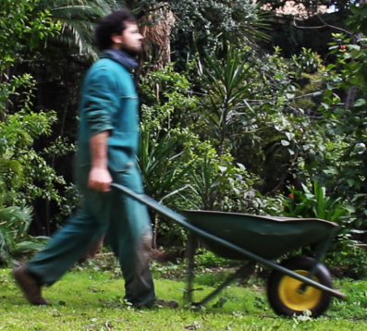
Your community
How could volunteers help out to make your community a better place?
Using the ideas and discussion in the previous activities, design a new volunteering scheme in your community. The scheme needs to respond to an issue or an organisation in your community.
WHY it is needed
WHERE it is needed
HOW it would help the community and the individual
It needs to promote the benefits of volunteering both to the organisation/issue and the individual taking part.

Slide 7
What would happen if all the volunteers in the organisations you have been discussing stopped giving their time?

