Slide 1
How can you respond?

Slide 2
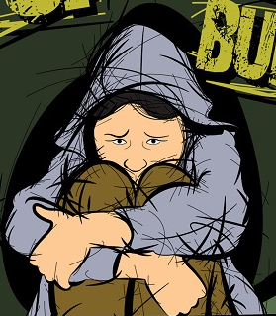
Think back to the previous session which introduced the idea of cyber bullying.
Can you come up with a definition of cyberbullying?
How does it compare to the definition in the student text book?

Slide 3
Case Study: Alex Holmes
When I was at school, I suffered from racist bullying. My dad’s side of the family is from Jamaica & my mum’s side from Spain. It made me feel shy, isolated and depressed. I can remember going home in tears quite often because of the bullying. As a 9 year old boy called Daniel reminded me recently, “It can feel like you’re a planet and you’ve been sucked into this internal realm of darkness.”
I was lucky as the Internet over wasn’t as big as it is now. There wasn’t Snapchat, there was MySpace. Apart from that, I could at least go home and escape the bullying.
When I was at home I had an idea: Anti-Bullying Ambassadors.
An Anti-Bullying Ambassador is someone whose job it is to stand up to bullying online and offline, protecting themselves and hopefully their friends. The programme has expanded significantly since then, spreading across the world – I recently trained all high schools in Miami. Something that started from pain, became a passion and a purpose.

Slide 4
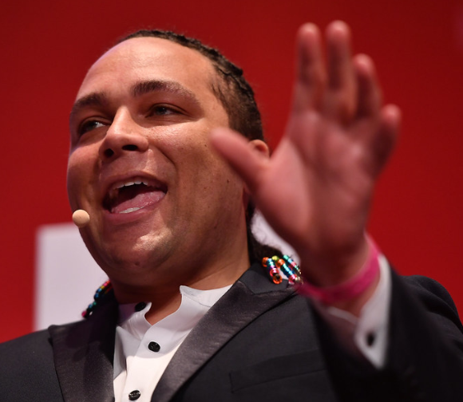
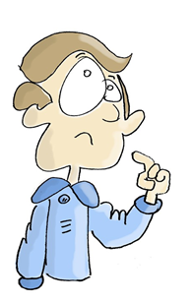
Case Study
How has Alex’s story of being bullied led him to setting up Anti-Bullying Ambassadors?
Which virtues would Alex have displayed in order to turn his negative experiences into the positive?
How can the online aspect of bullying make things worse for people being bullied?
How might you have helped Alex if you’d been a friend when he was being bullied?

Slide 5
Cyberbullying vs Banter
Look at the different posts, match the descriptions below to the pictures on the resource page and discuss which ones are examples of cyberbullying and which are examples of banter.
A negative conversation about someone over a Facebook status.
Logging in to another person’s Facebook account and posting on their behalf without their knowledge – known as ‘fraping’.
An Instagram photo which could either show two friends messing around or one girl attacking another.
A boy making very cruel comments about a girl’s Instagram photo.

Slide 6
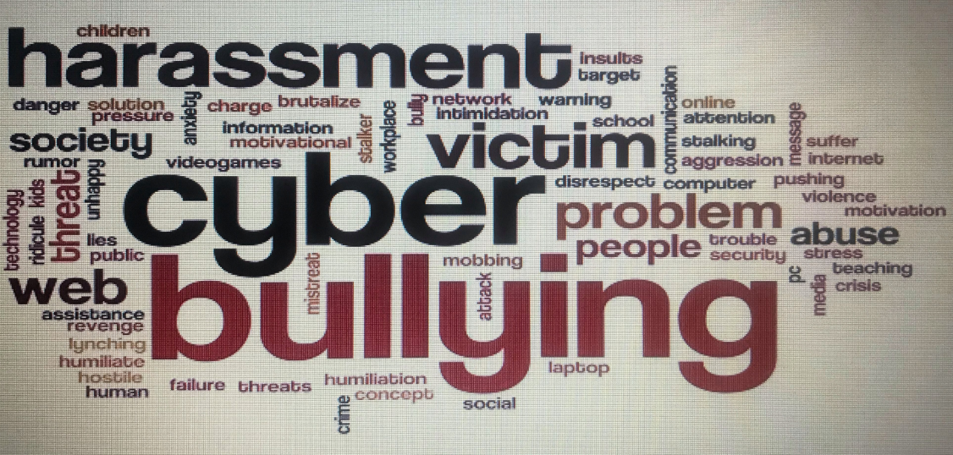
Someone being cruel to a person who has asked for help on Yahoo Answers.
Sharing an embarrassing Snapchat.
A text which could just be a joke between friends.
An abusive tweet.
A threatening message over Twitter.

Slide 7
“Often the right path is the one that may be hardest for you to follow. But the hard path is also the one that will make you grow as a human being.”
- Unknown
How might this quote relate to cyberbullying?
Do you agree with its message?
In what ways have you demonstrated the ‘right path?’

