Slide 1
Understanding Cyberbullying

Slide 2
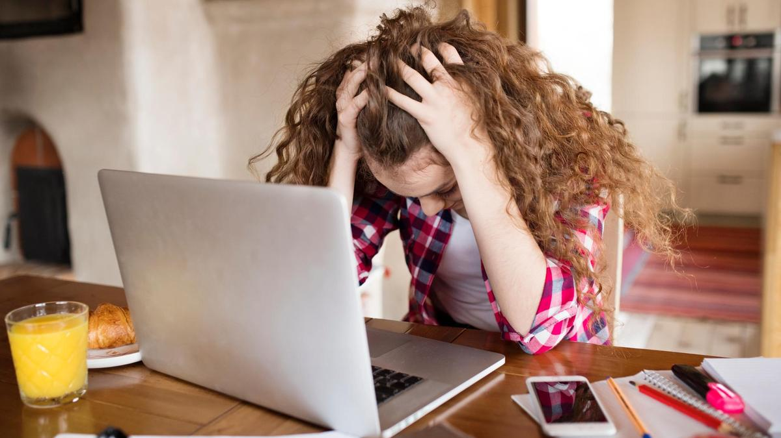
In order to really enjoy the power of the Internet, it is important for us to learn how to handle situations we encounter online responsibly and with wisdom so that we can keep our experiences positive.
What are some of the ways that people can cause harm and hurt other people’s feelings online?
What are some positive aspects of going online?

Slide 3
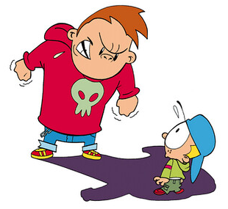
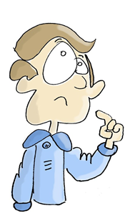
Activity 1: Reflect
How do you think it feels to be bullied, and why?
Have you ever experienced any bullying?
Reflect on your personal experiences and put yourself in the shoes of others who have been bullied. Common feelings might include: humiliated, sad, angry, helpless etc.

Slide 4
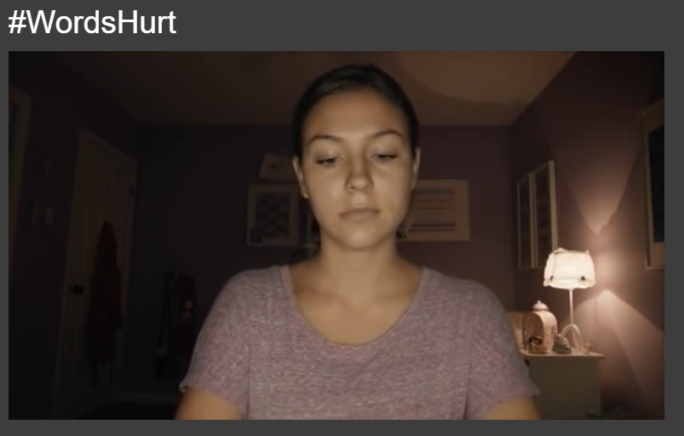
Online Activity:
Have a go at typing messages and observe the impact and the power of positive and negative words on the girl behind the computer.
How does encouragement and positive comments help to build-up your friendships online?
How does it feel to be the giver and recipient of positive comments and vice-versa?

Slide 5
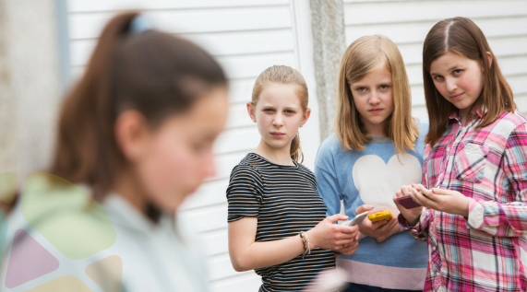
Sandra’s story
Read through Sandra’s story and decide whether you think it is an example of cyberbullying. Work through the questions with your partner
Sandra is planning a birthday sleepover. Her parents have set a limit of eight girls, so Sandra can’t invite everyone she’d like. Two girls, who are left out of the party, overhear the plans. They decide to create a “We Hate Sandra Jones” website. They say that anyone invited to the party should not go. They share the website with everyone in school. The girls also tell everyone to add new reasons why they hate Sondra and to spread mean rumours about her. When Sondra hears about the site, she gets a sick feeling in her stomach. Each day she finds a new mean comment or joke about her on the website. She feels hurt and embarrassed. She tells her parents she is sick, so she won’t have to go to school.

Slide 6
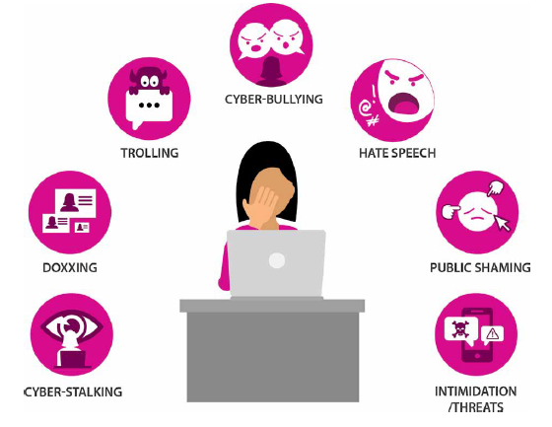
Is this a cyberbullying situation? If so, how is it cyberbullying?
How do you think Sandra might feel, other than embarrassed?
Why do you think the two girls created the mean website about Sandra?
What advice would you give Sandra about how to handle the situation?
How would you feel if you put yourself in Sonia’s shoes? Describe your emotions.
What do you think the people who are bullying Sondra would say about their behaviour?

Slide 7
Read the different scenarios below and use the words below to decide how the recipient would feel in each scenario.
A stranger comments on one of your pictures saying “You are so ugly” and 12 people like it.
You share a funny video on your social networking page and receive negative comments: “How is that funny?” “Why would anyone want to watch that?” “This is stupid!”
Someone keeps sending you text messages saying things like “I don’t like you, no one does!” “You’re an idiot.”
Someone in your school sends you a private message saying “No one likes you, loser!”
You upload a picture of you and a friend out and about at the weekend and someone leaves a comment saying “Omg why did you go there, ha how stupid!”
Small
Helpless
Annoyed
Embarrassed
Upset
Afraid

Slide 8
What would you do?
What advice would you give to someone who is being cyberbullied?
Someone who has seen cyberbullying happen?
Someone who has realised they have been unkind online?
What virtues would you need think about in each of these scenarios?
Can you think of practical examples of how you would use those virtues in these scenarios?
How can you develop your character in situations where you observe cyberbullying or feel tempted to say or do something you know is wrong online?

Slide 9
Building confidence
Watch the ‘Building confidence after online bullying’ clip.
Which of the three strategies do you most resonate with and why?

