Slide 1
Staying Safe

Slide 2
Social Media Quiz?
How many people in the world are on some type of social media?
How many YouTube videos are watched every day?
How much media is accessed on smartphones versus other devices?
How many social media accounts does the average person have?
How many messages are sent through Facebook Messenger and WhatsApp each day?
What percentage of internet searches are carried out by Google?
How many hours of video are uploaded to YouTube per hour?
What do the answers to these questions reveal about social media and the way people consume it?

Slide 3
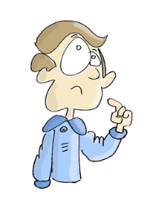
Watch the Digital Wildfire project video and answer these questions:
What positives and negatives of social media does the video show?
What does the video suggest you can do to help stop the negatives?
What virtues could you use to ensure you engage responsibly with social media?
How does engaging these virtues change the way you act towards other people online?
Which of these do you think you need to improve on? How might you go about doing that?

Slide 4
Your digital self
What can you do to take care of your digital self in these 3 areas?
Work in a small group to discuss your ideas.
Link a virtue to each point you make under the 3 headings.
Privacy and digital footprint | Think before you post | Asking for help

Slide 5
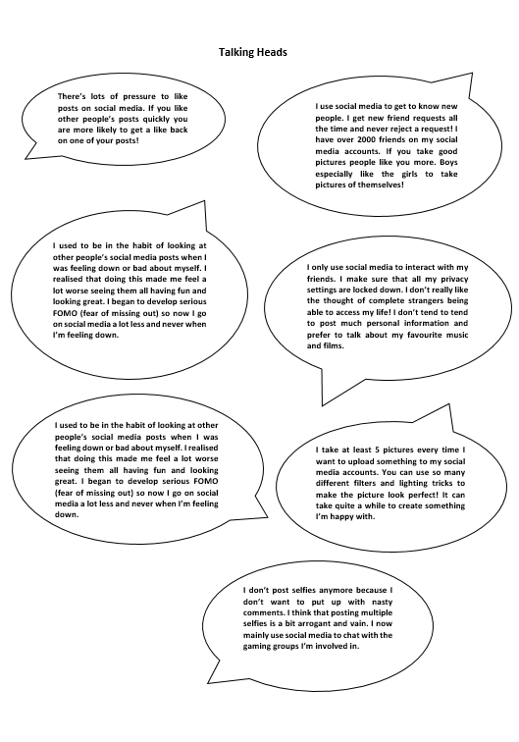
Read the ‘Talking Heads’ scenarios and the different experiences of using social media.
Can you identify similarities and differences in these people’s experiences of social media?
How do people use social media differently?
Have these people identified positives and negatives of social media?
Why do people take and post selfies?
How might using social media affect someone’s self-esteem?
Are any of these people’s opinions concerning? Why?

Slide 6
Moral Dilemma
Why is this situation challenging?
What do you think a wise solution to this problem is?
Is there more than one possible wise choice in this scenario?
What are some possible outcomes for the different choices she has in this situation?
My friend really annoyed me today. She made some nasty comments on my recent Instagram photo joking about what I was wearing. I’m tempted to post some embarrassing photos of her on my feed, it’s so easy to do. She’ll soon regret calling me names!

Slide 7
Ask for help and give advice!
I think my little brother is speaking to someone he doesn’t know on his snapchat. I have seen some private messages that someone has sent to him. He says he is OK but I am not sure. What should I do?
Write down some possible ways you could help your brother in this situation. Who might you need to talk to?
What virtues do you have to activate to intervene in this scenario?

