Slide 1
Developing through Exercise

Slide 2
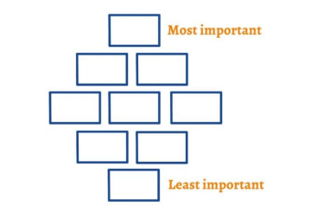
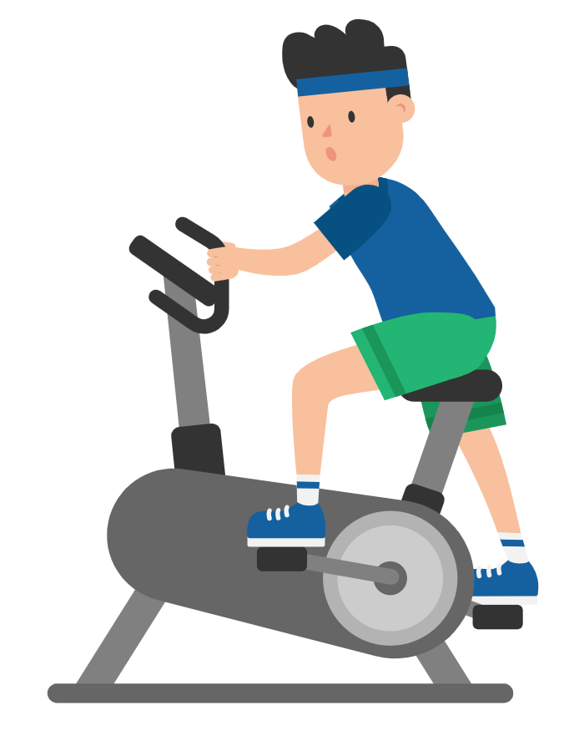
In pairs, brainstorm as many benefits to exercise as possible.
Once you’ve gathered you ideas rank them in a diamond nine in order of their importance.

Slide 3
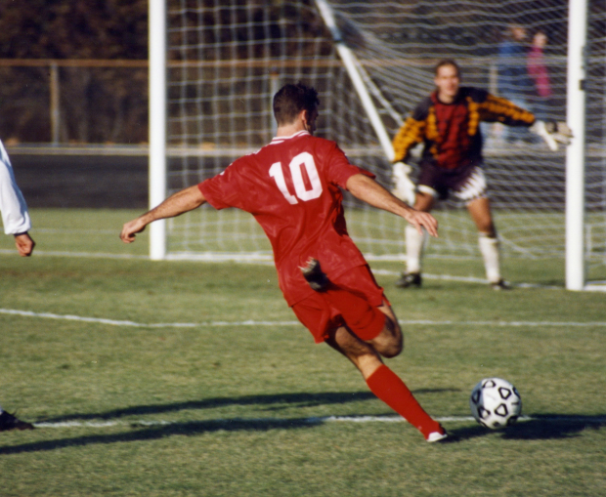
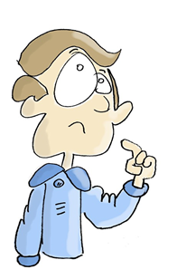
Write a short paragraph on your experiences of exercise and its benefits. Feedback to your partner about your experience.
How did you feel about taking part in exercise activities?
What types of virtues could you develop through exercise? Give some practical examples of how these might be developed.

Slide 4
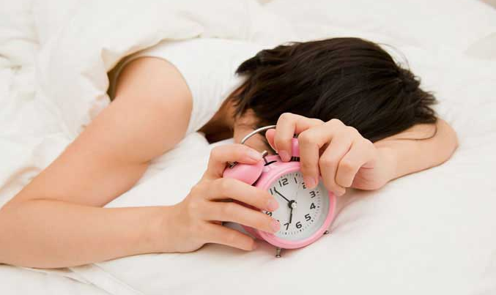
Create a mind map of all of the possible barriers to doing exercise. Do any of the reasons you’ve listed affect you? If so how and why?
What virtues do you need to overcome these barriers?
“It's not whether you get knocked down, it's whether you get up.” - Vince Lombardi
Do you agree with this quote? Share your thoughts with your partner.

Slide 5
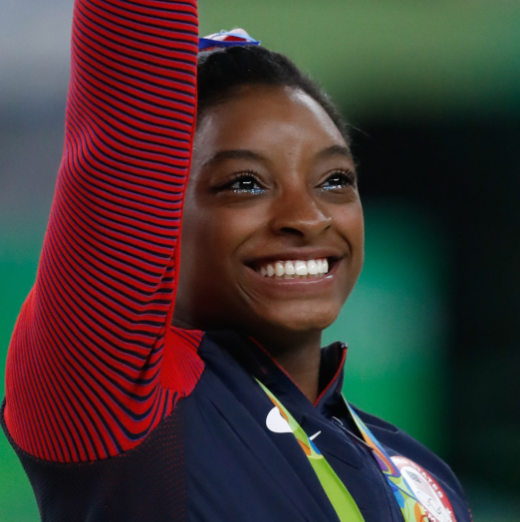
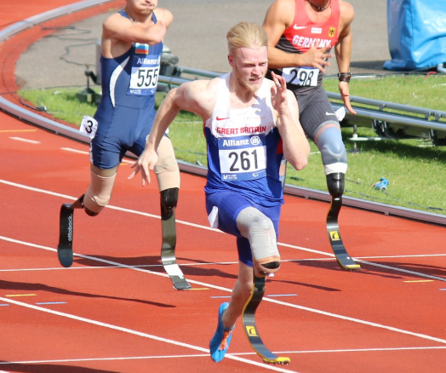
Simone Biles is a multi Olympic and World champion gymnast who many consider to be the greatest gymnast of all time. She is a modern day hero that overcame poverty and abuse. Growing up, Simone's mother wasn’t around to care for their family because of her drug addictions and Simone had to endure a challenging childhood. Simone and her siblings stayed in foster care until their grandparents, took in Simone and her younger sister, Adria, to later adopt them. Simone’s life changed when she was six and went on a class field trip to the gymnasium and while she was there, she was so impressed by the gymnasts that she knew right then she wanted to do the same.
Jonnie Peacock is an English runner who won the gold medal at the 2012 London Olympics and 2016 Summer Olympics, representing Great Britain in the men’s 100 metre event. At age 5, Peacock contracted meningococcal meningitis and septicaemia and as a result lost his right leg below the knee. This didn’t hinder Jonnie in his love of sport and he displayed amazing perseverance to become a world class athlete.

Slide 6
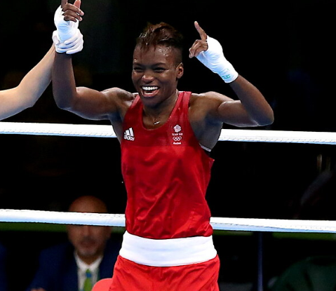
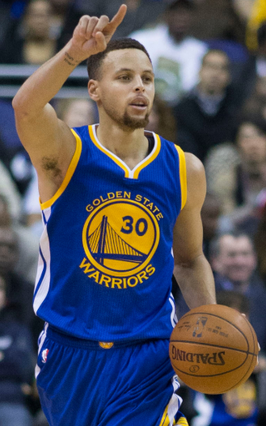
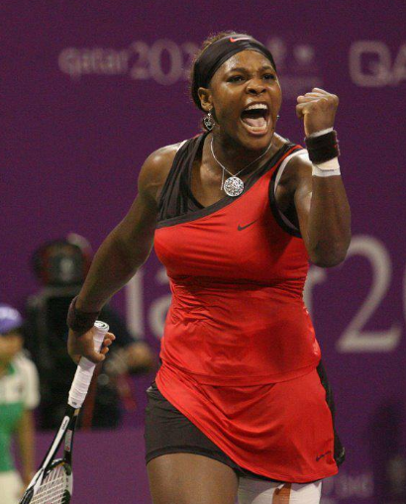
Both of these role models have overcome barriers to be at the top of their game.
What barriers have they overcome?
Which virtues have they shown?
Can you think of any other role models who have overcome barriers to succeed in sport? Create a fact file or presentation about them to share with your class.

