Slide 1
What is fake news?

Slide 2
Definition: False stories, that appear to be news, spread on the Internet or using other media, usually created to influence political views or as a joke. - Cambridge Dictionary Online

Slide 3
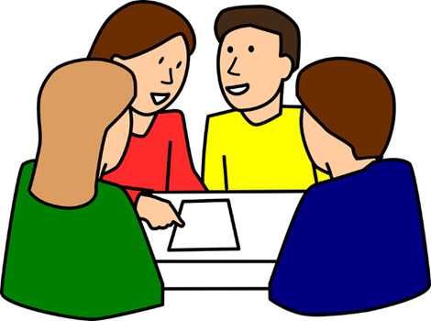
Have you ever seen/read any fake news?
What do you think about ‘fake news’?
Why do you think the use of the term has increased?
What virtues might be relevant to this lesson?
Image: pixabay.com

Slide 4
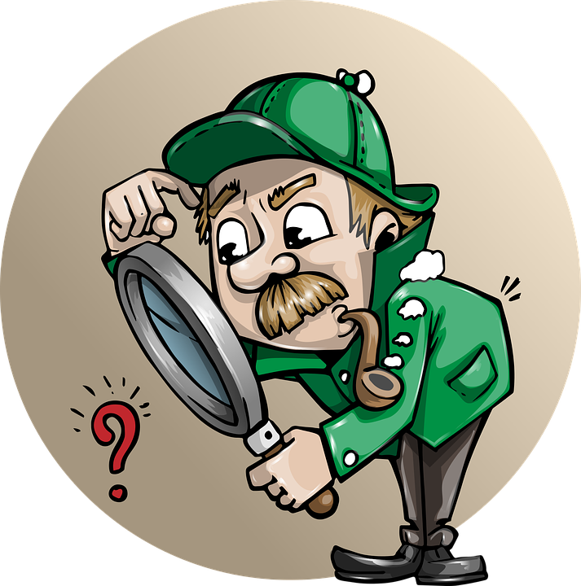
Working in partners, use:
https://www.bbc.co.uk/cbbc/quizzes/real-or-fake-news-quiz [accessed 28.05.2020] to see if you can spot which news stories are ‘fake news’.
How did you know/what clues are there?
Image: pixabay.com

Slide 5
What do you think the consequences of fake news could be?
Who are fake news articles written for?
What is the motivation behind writing fake news?
Image: pixabay.com

Slide 6
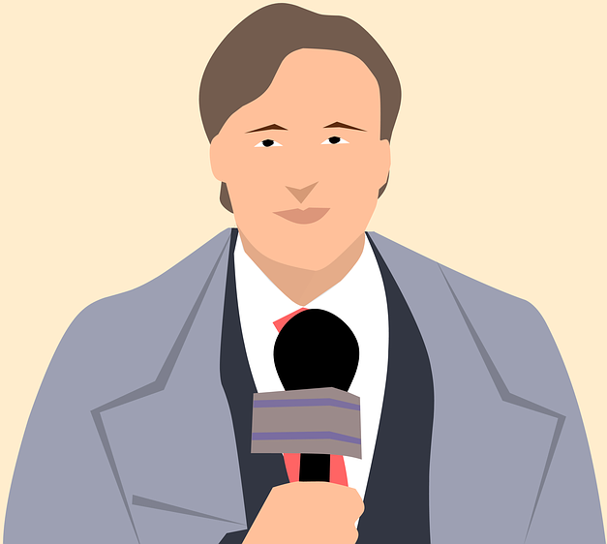
What skills and virtues do readers and journalists need so that we avoid fake news?
Image: pixabay.com
Image: commons.wikimedia.org

Slide 7
Watch the video on different types of fake news/false information online here:
https://www.bbc.co.uk/news/school-report-43391188 [accessed 28.05.2020].
Why might some people use the word ‘fake news’ to describe stories that are true?

