Slide 1
What stops people exercising?

Slide 2
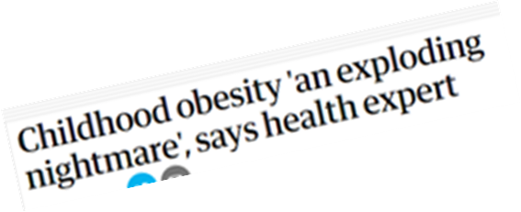
What are the risks of not exercising?

Slide 3
Brainstorm the barriers to doing exercise.
Swap your sheet with another group and, in a different colour, write down possible solutions to the barriers they have written down.
Swap with another group and, in a third colour, write down the virtues needed to enact the solutions.

Slide 4
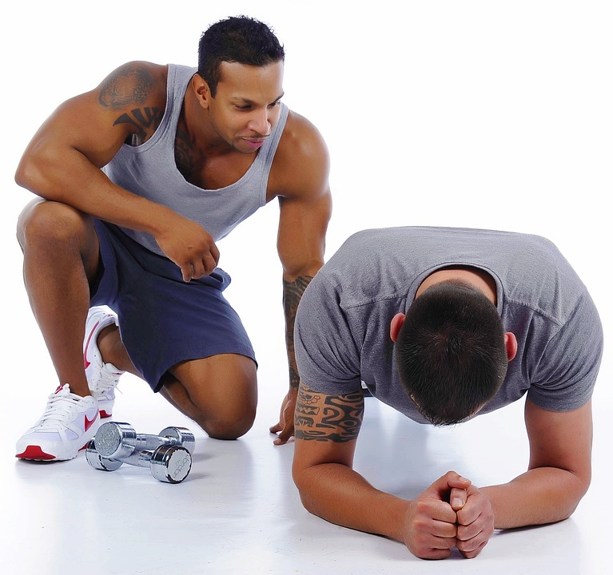
You are going to imagine that you are personal trainers and need to help a range of clients to start exercising.
Look at the scenarios and come up with some suggestions of how the person could incorporate some exercise into their life.

Slide 5
Jane is a busy mum who wants to do exercise to look after her health and have more energy. However, she says that she does not have time for exercise and does not want to spend lots of money on classes or equipment.

Slide 6
Omar hasn’t exercised for a long time and feels embarrassed when he goes out for a run or to the gym, because he feels really unfit. He is worried about what other people will think about him.

Slide 7
John really wants to do exercise and has tried some different types. He decided to start running last year but he finds it really boring. He is able to keep going for a few weeks and then he gives up.

Slide 8
Grace often plans to go to the gym or do a run after work but, at the end of the day, she is always too tired and heads straight home to watch TV.

Slide 9
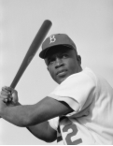
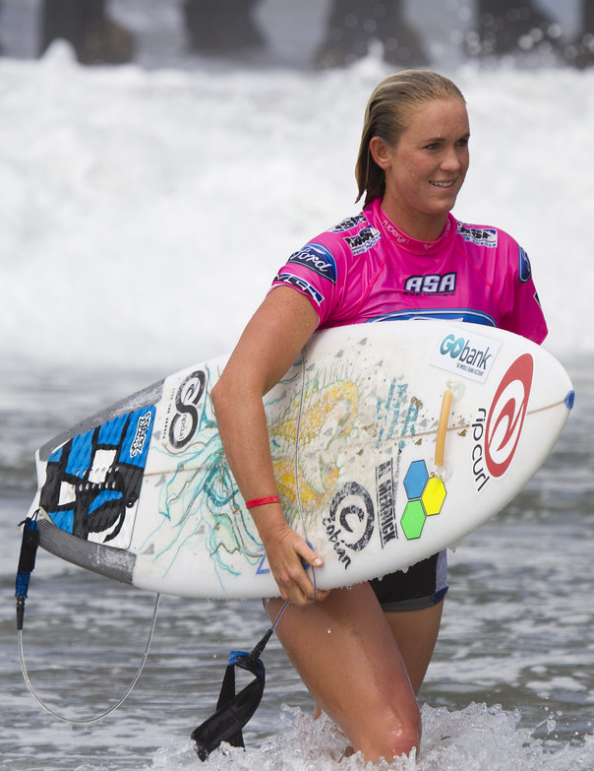
Playing for the Brooklyn Dodgers in 1947, Jack Roosevelt Robinson was the first African American to play in Major League Baseball. Until then, African Americans had only been able to play in the ‘Negro Leagues.’ Robinson had an exceptional 10 year career and was the first black player to be awarded the ‘National League Most Valuable Player Award’ in 1949. He was inducted into the Baseball Hall of Fame in 1962. Robinson's character, his use of nonviolence, and his unquestionable talent challenged the traditional basis of segregation which had then marked many other aspects of American life. He contributed significantly to the civil rights movement.
Aged 13, Bethany Hamilton survived a shark attack, while surfing. Her left arm was bitten off by a tiger shark and had to be amputated at a nearby hospital. Despite the trauma of the attack, she returned to surfing the following month. She initially used a custom made board and had to adapt her surfing style to take account of only using one arm. She entered a major competition a year after the attack and she is now recognised as one of the best female professional surfers in the world.
Image: en.wikipedia.org
Image: flikr.com
Each of these role models have overcome barriers to be at the top of their game. What barriers have they overcome? Which virtues have they shown?
Can you think of any other role models who have overcome barriers to succeed in sport?

