Slide 1
Your future, your world
Study skills and the virtues of learning

Slide 2
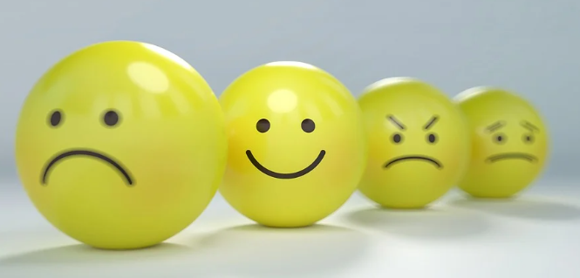
Are you looking forward to all the learning and content you will have to study in the run up to your exams?
If so, why? If not, why not?
Is there something you could do or change to ensure you think positively about the year ahead?

Slide 3
Learning is something that you are involved with in many areas of your life.
What does the word ‘learning’ mean? What does it mean to be involved in learning?
What image do you conjure up when you think about the word ‘learning’?
In what areas of your life are you involved in learning? Where and how does this take place?
Do you consider yourself to be someone who enjoys learning?

Slide 4
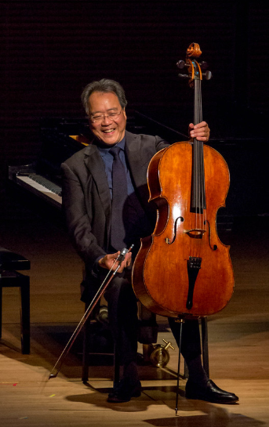
Think of someone who you know that is an expert (or really good) at something. This might be academic in nature, a skill, a career or vocation.
Discuss with your partner what it must have taken for that person to have become so good at their craft?
What skills would they need to have honed to become an expert? What virtues would they have to have practiced?

Slide 5
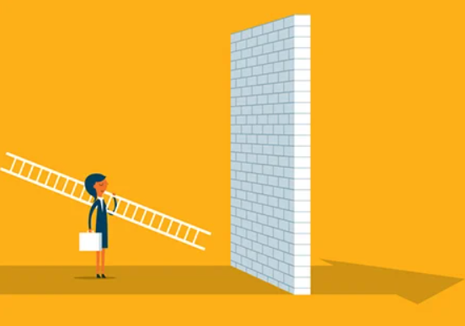
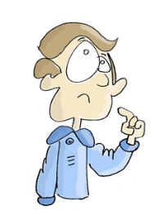
Barriers to my learning
What are the main challenges you face in your learning?
What types of barriers to learning do you face?
Share these challenges with your partner and reflect together on the context for these barriers.

Slide 6
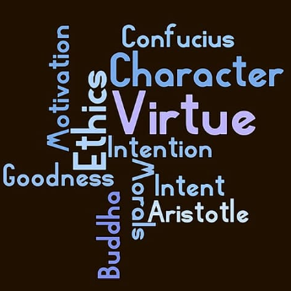
What did you do to overcome the challenges and barriers to learning that you faced?
Were you able to overcome them or was it easier to give up?
Which of the virtues that you’ve been thinking about might relate to the issues of overcoming barriers to learning?
How might virtues such as justice, resilience, courage, curiosity and self-discipline relate to this issue?

Slide 7
The benefits of learning
What might be the benefits of ‘learning how to learn’ effectively at this stage in your life and education? How might that effect your future?
What motivates you to learn? Is it qualifications? Being the best in the class?
How might the concept of becoming a ‘lifelong learner’ be a factor in your desire to enjoy and excel in learning?
Is lifelong learning something that you consider to be worthwhile or that you aspire to? If so, why?

Slide 8
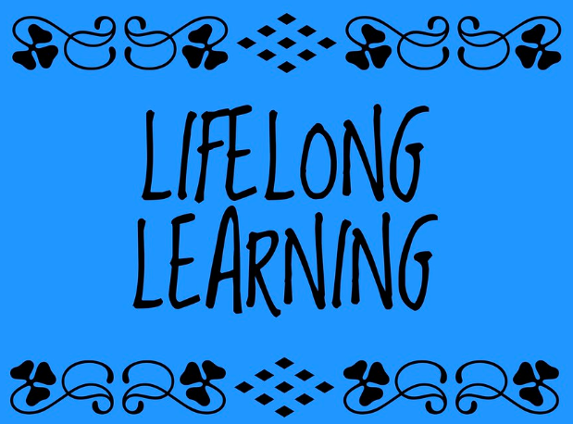
What character virtues might you need to develop as a ‘lifelong learner’?
Write a journal article outlining how you intend to develop as a ‘lifelong learner’.
Ensure you reflect on the virtues you need in order to develop as a learner this year in the lead up to exams as well as later in your life.

Slide 9
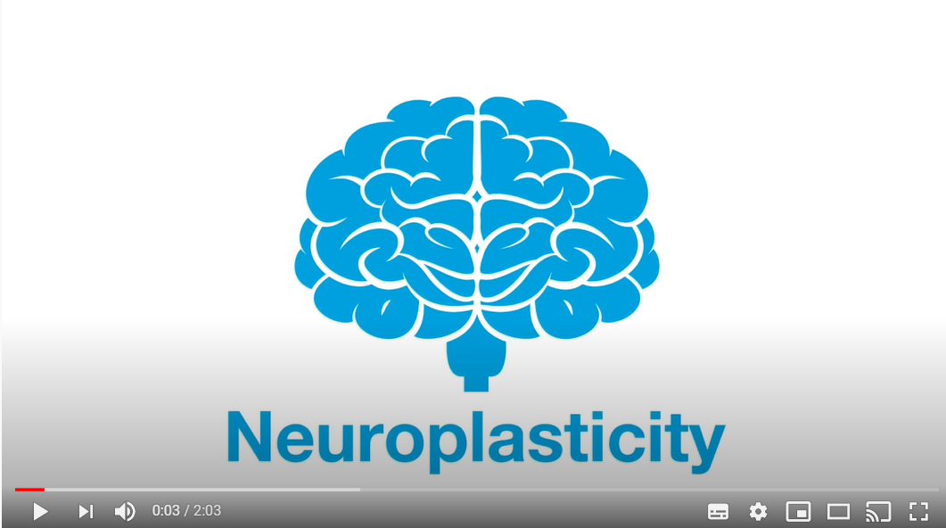
Your brain on learning
Watch this short video which describes the science behind neuroplasticity.
What does the video say about developing habits?
How does that relate to you developing your learning?
What are the implications for you knowing that the brain shapes itself according to your experience and habits?

Slide 10
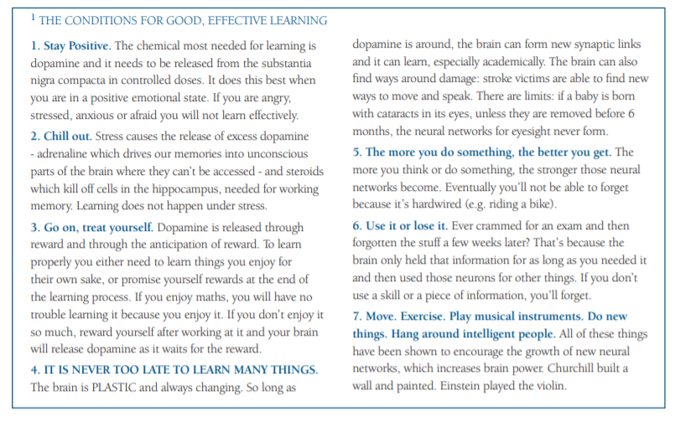
Read through the various ‘conditions for good, effective learning’.
How might you apply these ideas to your school life?

Slide 11
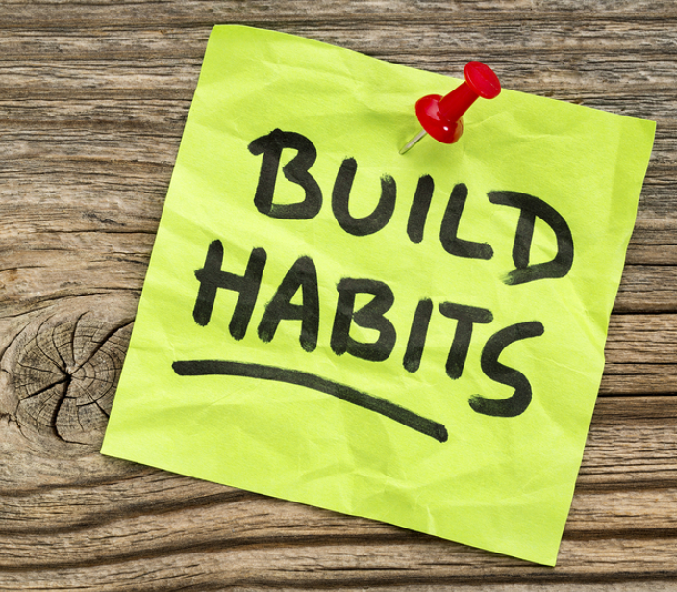
Developing habits
Virtuous behaviour emerges from habits. Habits are formed in the brain through repetition.
Think about 2 or 3 new learning habits that you need to form through repetition in the build up to your exams.
How are you going to go about forming those habits and whose help are you going to enlist in forming them?
Work with a partner to discuss what habits you plan to develop. How might you use these habits in different aspects of your life and in different stages of your life?

