Slide 1
Your future, your world
Character strengths for my future

Slide 2
Can you think of any links between people’s job roles and their personal strengths or character traits?
Can you give any examples of people in your family or friends where this seems applicable?
How do you feel when you are involved in doing something that you are really good at or are really interested in?
Discuss with a partner and create a mind map of all the words that you come up with.

Slide 3
The VIA
You are going to think about which virtues are most important to you. Individually complete the adapted VIA survey to identify your most valued virtues.
Why have you chosen those virtues?
Have you chosen the same/different virtues?
Are the virtues that they have chosen predominantly moral/civic/intellectual/performance?

Slide 4
Choose 1 virtue, from your top 4 or bottom 4, which you would like to develop further.
You should complete an action plan:
What could you do practically to practice this virtue?
What might be the barriers to developing this virtue?
How could you overcome or limit these barriers?

Slide 5
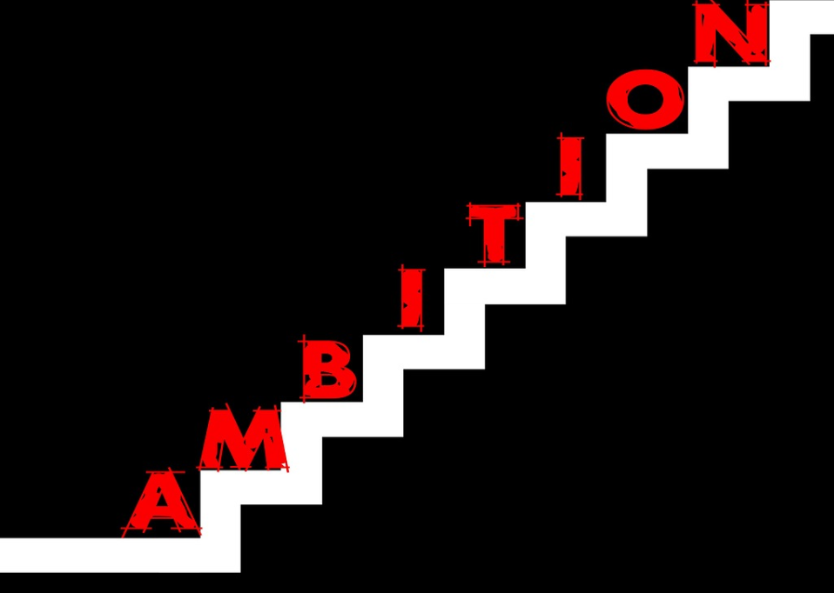
How recognising our skills can help us to make good career decisions
What does it mean to have ambitions or goals?
What does it say about you if you’re someone with ambitions and goals?
What does ‘aspiration’ mean?
What are your ambitions for the future?

Slide 6
Some people might have short/medium/long-term goals. What would a goal in each of those categories look like?
Share some examples of ambitions/goals for your life in education or entering the world of work.
These might be long-term goals that might need to be broken down into smaller goals to achieve or they might be more short-term and realistic ambitions for the near future.

Slide 7
Have a look at the list of jobs, skills and character traits to give you some idea of the differences between them and also how they might connect with one another.
Which character traits fit with the skills and job roles listed? Can you see yourself working in any of these roles? If so, can you link them to skills and character traits you might need?

Slide 8
Interests | Skills | Character Traits
Fashion | Organisation | Integrity
Current affairs | Teamwork | Patience
Environment | Problem solving | Empathy
Public Services | Communication | Compassion
Arts | Creativity | Resilience
Sciences | Leadership | Curiosity
Reading | Positivity | Confidence
Languages and travelling | Innovation | Humility
Finance and Business | Proactivity | Respectfulness
Writing and social media | Numeracy | Honesty
Law and Justice | Decision making | Service

Slide 9
Self-reflection
There are different ways of reflecting about the right subject to study in the future or a certain choice of career.
Start with you | Find your skills, interests and character traits | Find job roles that are a good match
Or
Start with a job role idea | Find out what skills, interests and personality traits it needs | Compare with your skills, interests and personality traits | Work out what you need to build on or improve

Slide 10
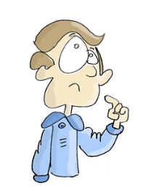
Which route do you find is most helpful for you? Discuss with your partner.
Write a journal entry discussing your ideas for a route into further education or further ahead and the career you’d like to work towards.
Describe your thinking by using the one of the self-reflection routes you’ve just discussed with your partner.

Slide 11
Think about the activities you’ve explored today around vocation and character skills/traits.
Did any of your reflections surprise you? If so why?
Did you find it helpful to reflect on your strengths and consider how that might apply to your future?
Is there anything that you might like to find out more about?
A lot of your thinking about the future will need to be kept up-to-date and returned to as you develop new and existing skills though KS4-5 and beyond and as you mature and develop.

