Slide 1
The Online World
Online gambling and addiction

Slide 2
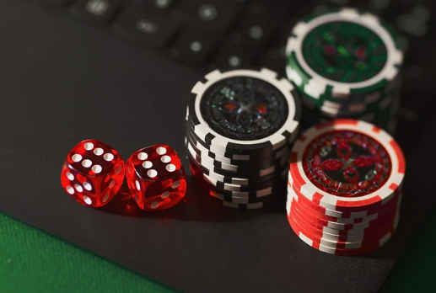
Why might online gambling or gambling in general be a topic for discussion? Why might people need to be educated in it?
Do you consider online gambling to be an issue that needs to be discussed in school? Discuss with a partner and feedback to the group.
Come up with a definition of ‘gambling’ with a partner. What is the official definition?

Slide 3
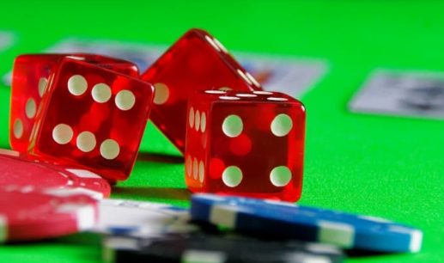
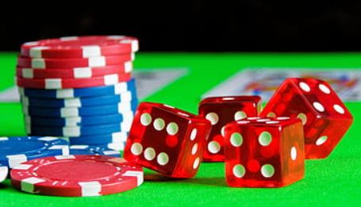
In law, gambling is defined by the 2005 Gambling Act as
‘betting, gaming or participating in a lottery’.
Some of the different categories of gambling include:
Arcades (those for adults and those for families)
Betting (online, at an event or in a high street bookmakers)
Bingo (online or in a bingo hall)
Casino (online or in a casino)
Lotteries (raffles, tombolas, sweepstakes etc.)
Gaming machines (fruit machines, fixed odds betting terminals etc.)

Slide 4
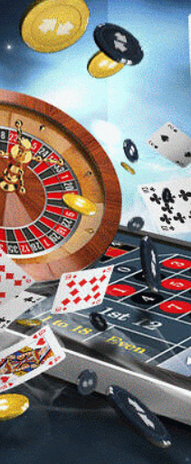
Online Gambling statistics
Is there anything that surprises you within this information? If so, what? Why is it a surprise?
46% of Brits have gambled in some way in the last 4 weeks.
On average Brits spend £2.57 per week on gambling, totalling over £133 per year.
28% of Brits have taken part in the National Lottery in the last 4 weeks, making it the most popular type of gambling.
The gambling industry was worth £14.5 billion in Great Britain in 2018, employing more than 106,000 people.
Gambling addiction is estimated to cost the UK up to £1.2 billion per year.

Slide 5
What are your opinions/experiences of online gambling?
Is it something you’ve come across before? If so, where/how?
On what platforms or devices is online gambling most visible? E.g. sport?
Why do you think online gambling is present on these platforms?
How does online gambling ‘hook’ people in? How and why might it become a problem?

Slide 6
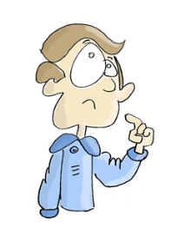
Addiction
Gambling is not a drug, but the effects can be very similar. Since the start of online gambling there has been a surge in people becoming addicted.
When you hear the word ‘addiction’ what do you think of?
Do you think it is possible to become addicted to online gambling?

Slide 7
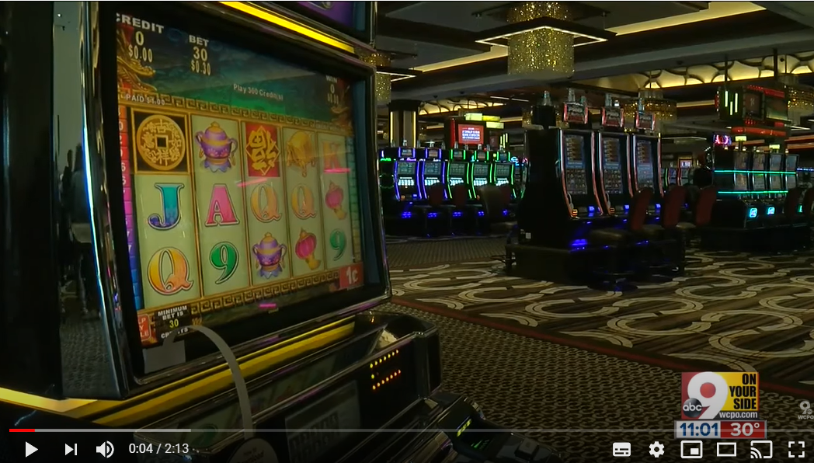
Watch this video about high school students gambling online in the USA.
Do you agree with the man in the film that ‘gambling is just like any other addiction’?
Which sort of character virtues might be useful in combatting an addiction or problem with an issue like gambling? How might they be helpful?

Slide 8
Discuss these question in a group and feedback to the class.
What is the difference between occasional and experiential use when it comes to gambling?
Experiential use - where a person tries a drug or an activity such as gambling to see what it is like.
Occasional use - where a person uses the drug, or gambles, rarely.

Slide 9
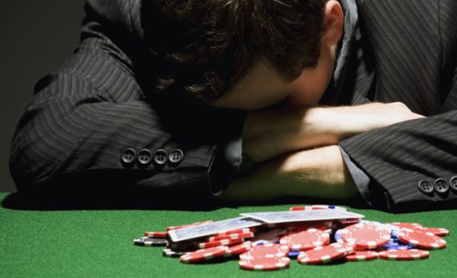
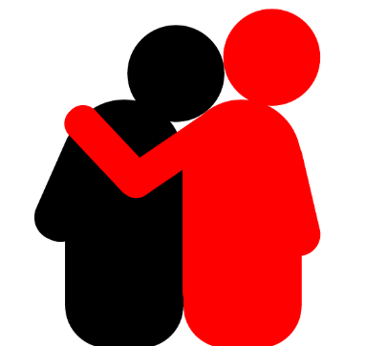
If we work from the place that having a habit or dependency to online gambling are not good things, how might a friend help someone to overcome their addiction?
How would you help someone that you know who might be struggling in this area?
Which virtues would you be using in giving help to someone?

Slide 10
Dilemma 1
Jamie’s family doesn’t have much money. She often wishes that she had the kind of things that her friends have, such as designer clothes and the latest phone. When she’s out at the newsagents, Jamie sees a story on a newspaper front cover about a man who won the lottery.
She has £20 birthday money and sees the lottery kiosk.

Slide 11
Dilemma 2
David is looking at Instagram at home one night and sees an advert on his feed advertising a new sports betting site which is giving away free bets. To play, he needs to enter a credit card number. He takes his brother’s card, justifying his decision as he is doing no harm because he only intends to use the free bets and not pay for anything on the card. David places free bets for that evening’s football match and the buzz he gets is amazing. During the game he thinks of ways to spend his winnings if things go his way.
At one point he is out of free play but is very close to the jackpot. He is tempted to pay to carry on playing.

Slide 12
Dilemma 3
Ryan and his friends spend a lot of time gaming online. They have become very successful in various strategy and war games and have discussed whether they should now use these skills to make some money from online gambling. Ryan and his friends are all good at maths, understand odds and card games and think they can make lots of money playing online poker. It’s Saturday afternoon and Ryan and his friends start taking steps to make it happen.
He has saved up £80 to go and see a favourite band he likes later in the summer.

Slide 13
Dilemmas
Read the 3 dilemmas and discuss with a partner:
How is each character in the dilemma feeling?
What is the dilemma that each person faces?
What would you advise each person to do in that scenario and why?
Think about an ‘in the moment’ response and a slower response, based on evidence.
Discuss as a group the reasons why people might take the risks associated with gambling and the issues each character is facing in that scenario.

Slide 14
Reflective journal
Write a reflective journal piece outlining the growing trend in online gambling and responding to the following questions.
What factors influence how we think about online gambling?
How can we be resilient in the face of these influences?
How can people ensure they make better choices around gambling behaviour?
How can we play a part in being a positive influence?

