Slide 1
COMMUNICATING ABOUT CHARACTER
MATERIALS TO SUPPORT SCHOOLS TO DELIVER A WORKSHOP FOR PARENTS AND TEACHERS ON CHARACTER EDUCATION.
Slide 1

Slide 2
Purpose of the Workshop
To provide an opportunity for parents and teachers to talk about character development in young people.
Slide 2

Slide 3
Goals for Today’s Workshop
What would you like to get out of today’s workshop?
Write your answer on a sticky note.
Slide 3

Slide 4
Key Definitions
Virtues: positive, personal strengths.
Character: our own set of virtues that lead to appropriate moral action.
Character education: all activities in and outside of school that help students to develop these virtues.
Slide 4

Slide 5
What Matters Most?
MOST VALUED
1
You have been given 9 characteristics or virtues.
Which virtues do you value the most in your children/pupils?
Rank them in a diamond shape, with the virtue you value the most at the top.
2
2
3
3
3
4
4
5
LESS VALUED
‘Diamond 9’ template idea from TeachIt (2006): http://www.tigurl.org/images/tiged/docs/activities/1493.pdf (Accessed: 1 May 2020)
Slide 5

Slide 6
Character Development
Discuss the following questions in small groups:
What type of person do you want your child/student(s) to become?
How do we develop good character?
Whose responsibility is it to develop character in young people?
How should we support young people to develop good character?
Slide 6

Slide 7
Opportunities for Character Development
What opportunities are there available for students to:
Develop their character during the school day?
Develop their character outside of the school day?
Slide 7

Slide 8
What the Research Shows
When asked whether they prioritised good GCSE results or good character: 69% of parents and 72% of teachers chose character.
However:
75% of teachers and 81% of parents believed their counterparts valued good GCSE grades over character.
Harrison, T., Dineen, K., and Moller, F. (2018) Parent-teacher Partnerships: Barriers and Enablers to Collaborative Character Education, Birmingham: Jubilee Centre for Character and Virtues, University of Birmingham
Slide 8

Slide 9
Practical Wisdom
The ultimate aim of character education is the development of practical wisdom.
This is the ability to choose intelligently between alternatives in a particular situation.
To do this, you need to know how to choose an appropriate course of action in different, difficult situations.
Slide 9

Slide 10
Moral Dilemmas: Example
Your son is in Year 7. He has been invited to a birthday party where they will be playing the latest video game, which you know has a 15 age rating. He says that all his friends are allowed to play the game, and he’s worried that they will exclude him if he isn’t allowed to play it too.
What do you do?
Slide 10

Slide 11
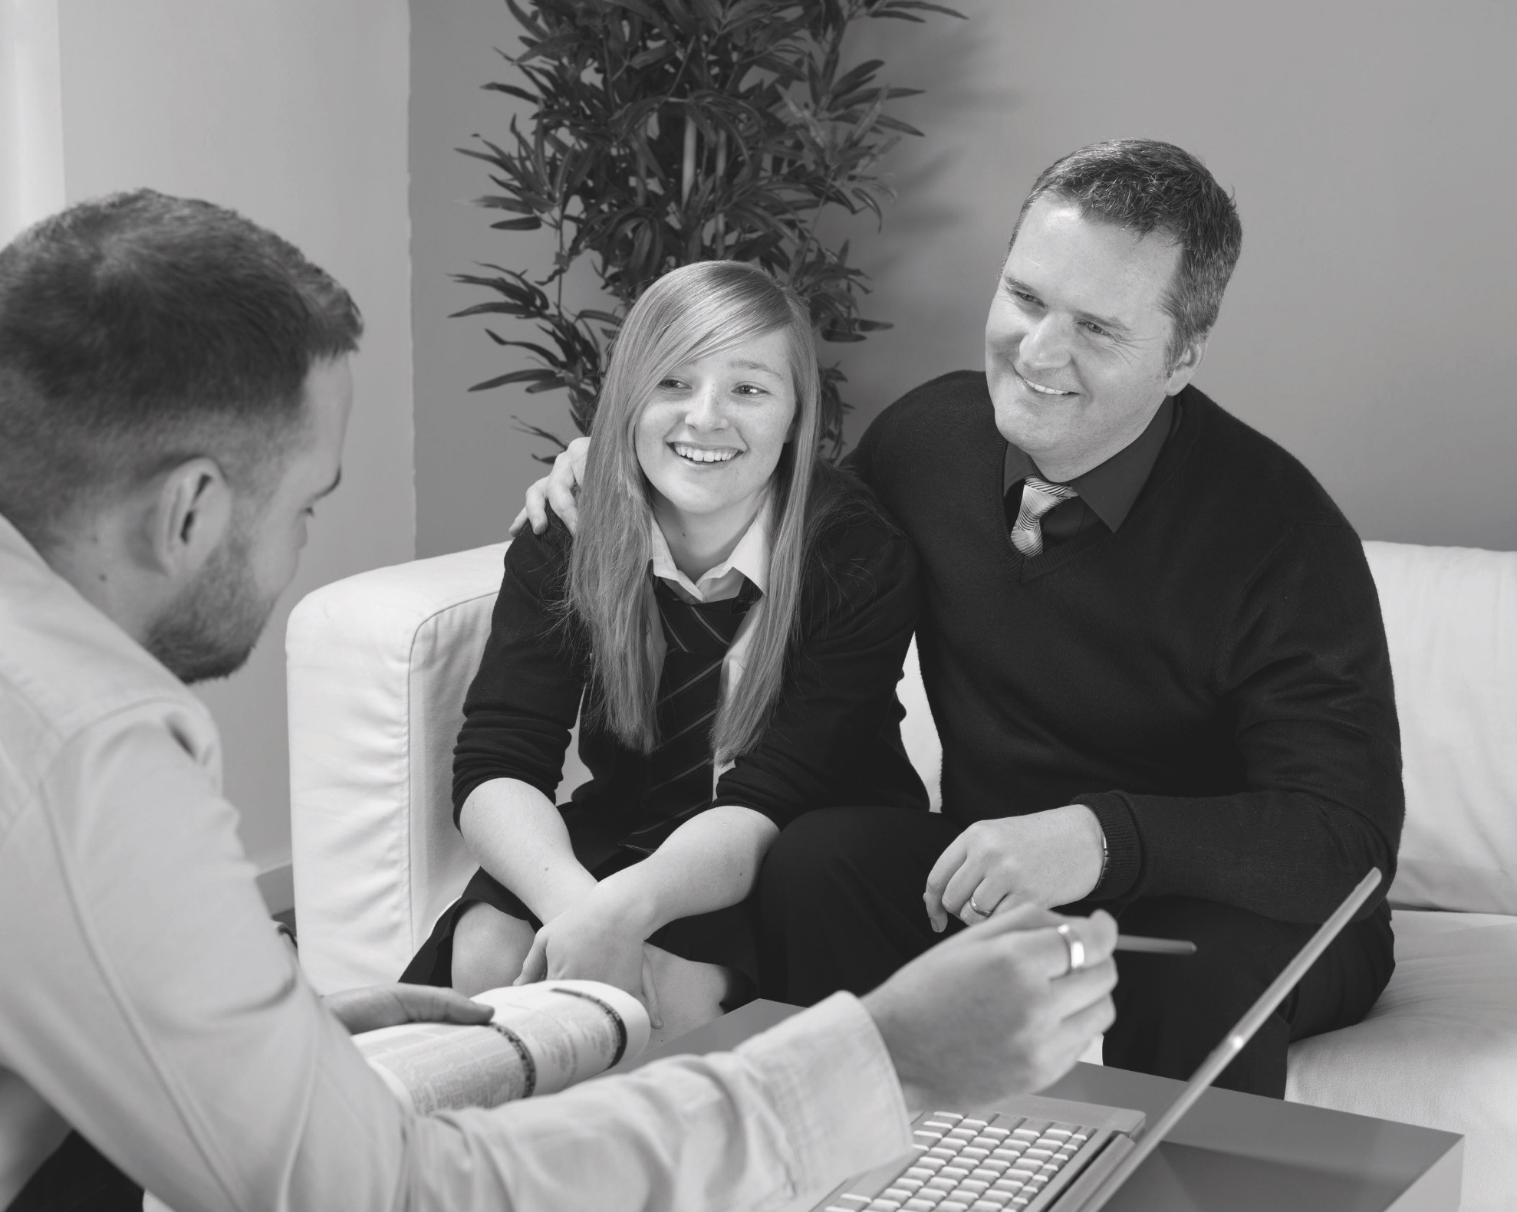
Moral Dilemmas 1:
Your daughter (Emily) is in Year 7 and applied to be a volunteer school librarian. She was excited when she was accepted for the position – there were lots of applications!
You have both signed a permission slip saying that Emily will commit for 1 term. She attends 3 times and then says that she cannot be bothered anymore. There is a revision session at the same time that she says will help with her maths, which she is finding hard.
As a parent/teacher what would you encourage Emily to do in this situation?
Which virtues are in conflict here?
Slide 11

Slide 12
Moral Dilemmas: 2
Daniel is part of a Snapchat group with a bunch of his friends in the same year at school. The focus of the group is usually on the recent football results and games they are all playing online.
More recently, a new student called Jeevan has been added to the group, and a number of Daniel’s friends have started to post unpleasant and aggressive messages towards Jeevan. They have also made their identities anonymous using a new feature of the app.
Jeevan’s parents have made a formal complaint to the school and asked them to find out who has been posting the threatening messages. Daniel has been asked to see the Head of Year (being one of the group members) about this. Daniel thinks he knows which of the group have sent the messages, but he isn’t 100% sure. He also doesn’t want to get his friends into trouble.
As a parent/teacher what would you encourage Daniel to do in this situation?
Why is this a difficult decision for Daniel?
Which virtues is Daniel having to balance here?
Slide 12

Slide 13
Evaluation
Has this workshop been useful?
Where do we go from here?
How can we continue working together in the future?
Slide 13

