Slide 1
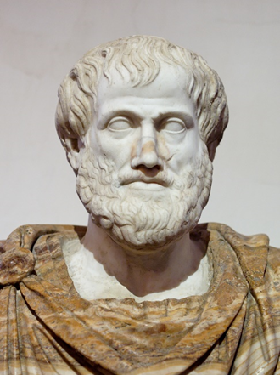
Who was Aristotle?

Slide 2
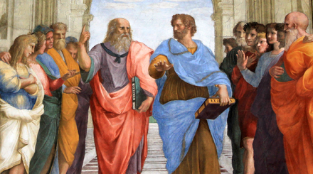
What you can see?
What you can infer about Aristotle?
What questions you would like to ask about Aristotle?

Slide 3
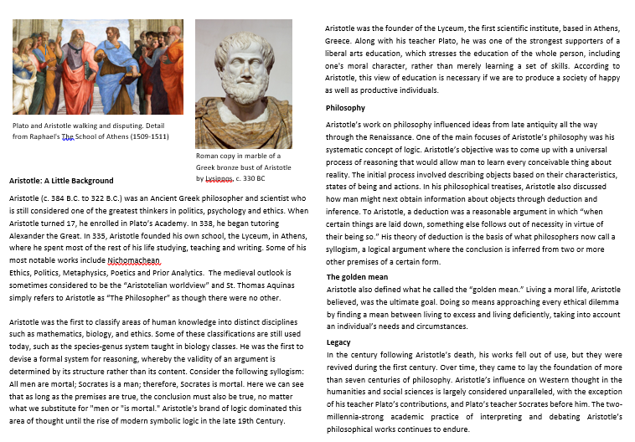
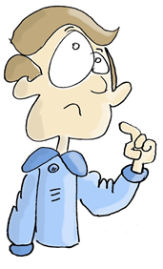
Use the information sheet to create an ‘Aristotle Fact File’, building up a picture of who Aristotle was.
You can display your fact file as a poster or comic strip depicting the main events of his life.
Based on your research today, which three words would you use to describe Aristotle? Why have you chosen those words?

Slide 4
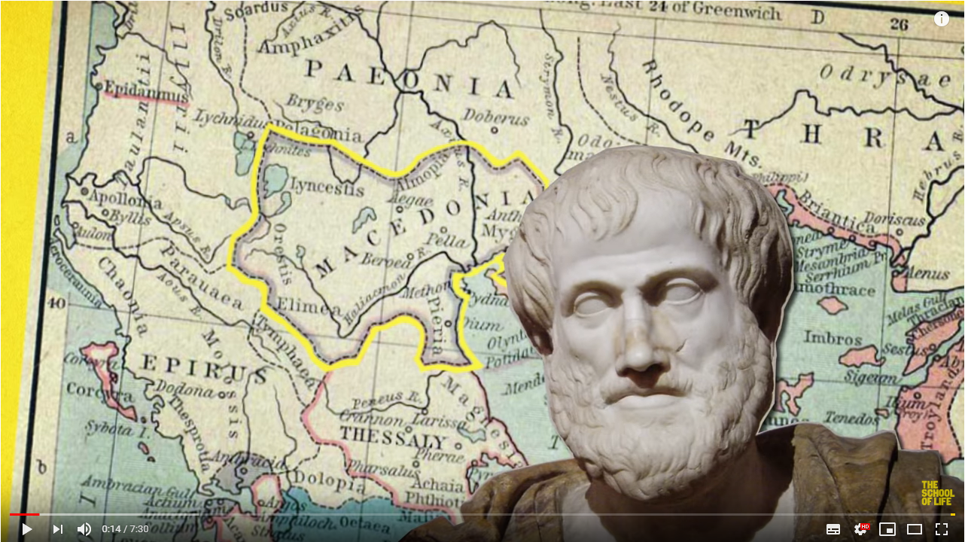
Watch the first 3 minutes of this video about Aristotle and using the information answer the questions:
What makes people happy?
What makes your life happy?
www.youtube.com/watch?v=csIW4W_DYX4&t=119s

Slide 5
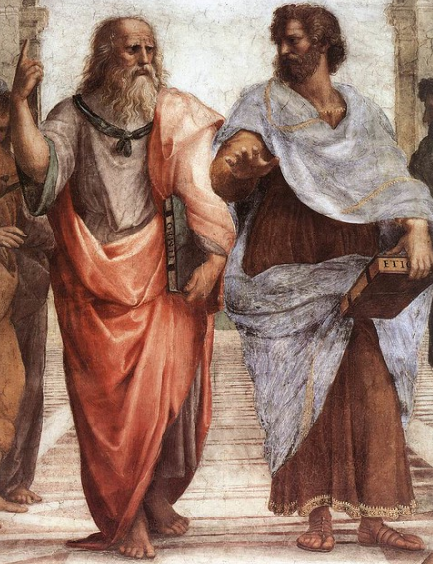
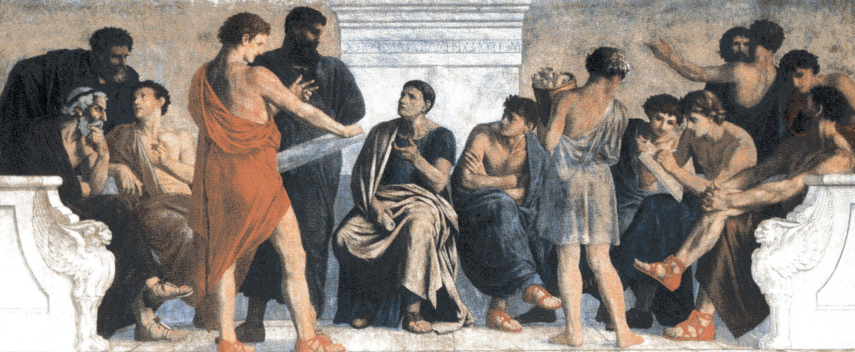
“We are what we repeatedly do. Excellence, then, is not an act, but a habit.” ― Aristotle
Based on your research today, which three words would you use to describe Aristotle?
Why have you chosen those words?
Do you agree with Aristotle’s point?
Can you think of any examples where good habits lead to good outcomes?

