Slide 1
What effects do harmful substances have?

Slide 2
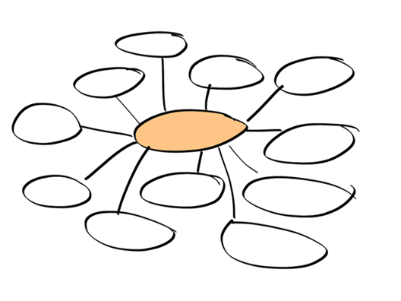
Thinking about cigarettes, alcohol and illegal drugs, what are the different reasons that people might take them?
Image: pixabay.com

Slide 3
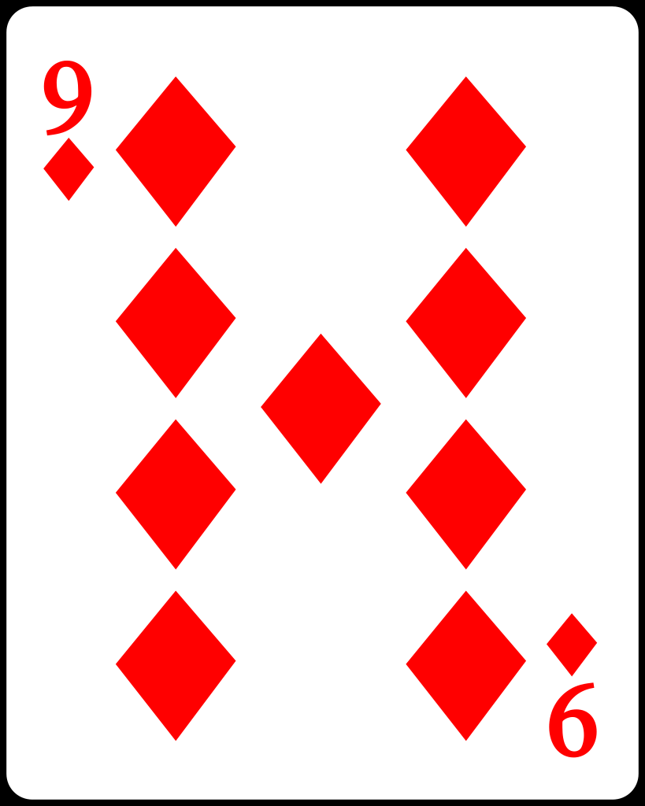
Use the diamond 9 cards to rank the effects from least serious (at the bottom) to most serious (at the top). You will be looking at either cigarettes or alcohol. Then you will share your decisions with a group who looked at the other substance.
Image: commons.wikimedia.org

Slide 4
Most people who smoke, drink too much alcohol or take illegal drugs know about the negative side effects but still take them. Why?

Slide 5
Habits can be very hard to change. Cigarettes, alcohol and drugs all contain addictive properties that mean that people can find it almost impossible to quit. If this is the case, they need to seek professional help from their doctor. What virtues do we need to develop to avoid cigarettes and misusing alcohol?

Slide 6
If someone you know wants help to stop using cigarettes, alcohol or drugs, where can they go?

