Slide 1
What is a family?

Slide 2
What does family look like? What does family smell like? What does family sound like? What does family feel like?

Slide 3
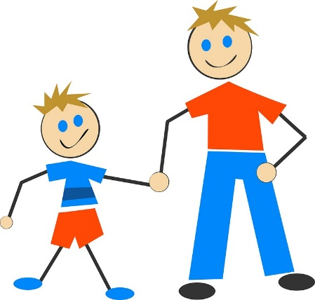
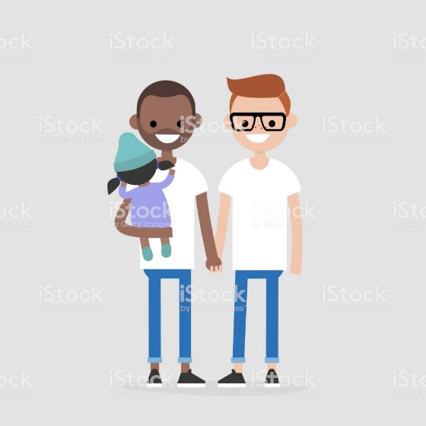
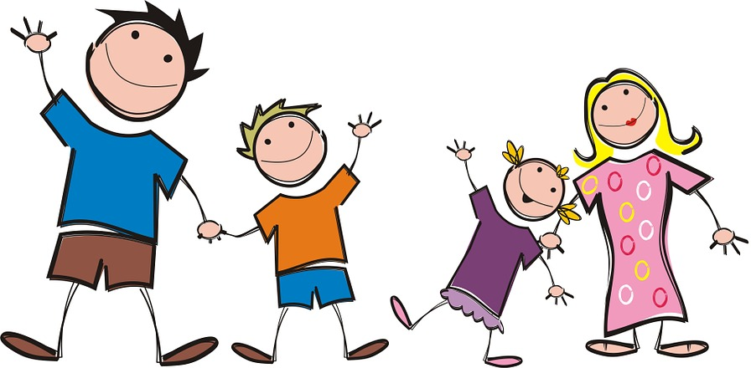
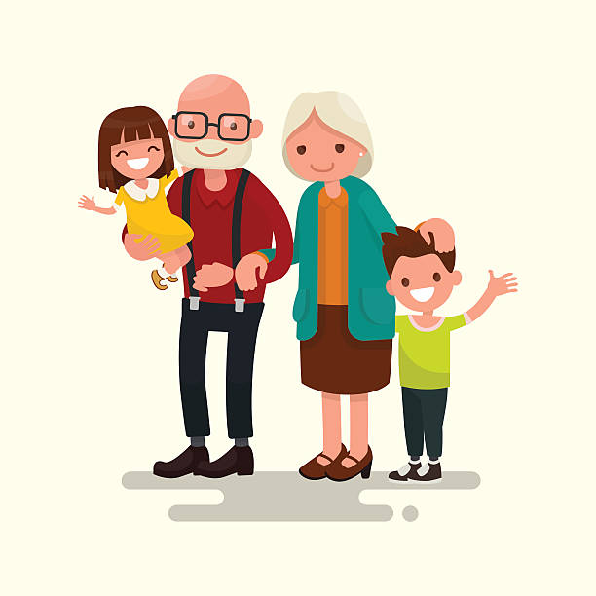
Families can come in all shapes and sizes.
Image: pixabay.com
Image: pixabay.com
Image: istockphoto.com
Image: istockphoto.com
How can we show respect to other people’s families?

Slide 4
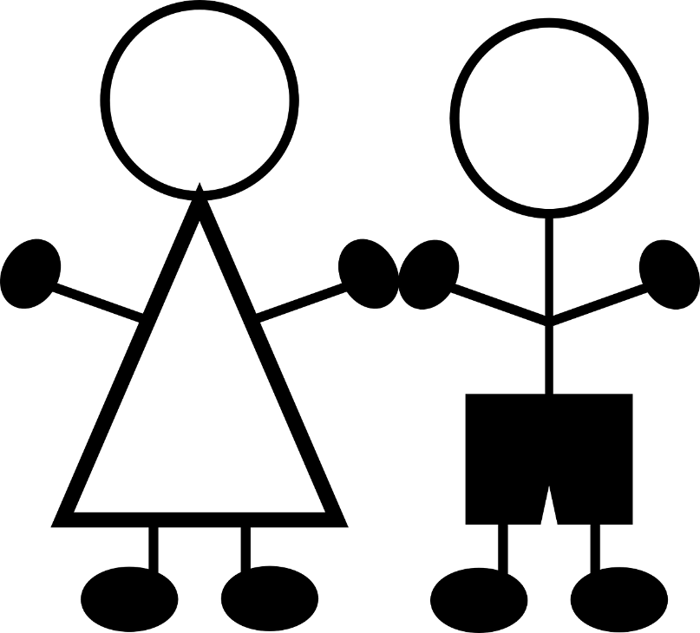
Who is in your family? Draw a picture of your family and answer the following questions:
- Who is in your family? What are they like?
What do you enjoy doing together?
Do you have any special family traditions, celebrations or routines?
- Are there specific virtues that are really important to your family?
Image: needpix.com

Slide 5
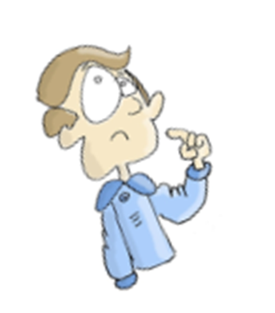
Thinking about your family, write down three things that you are grateful for.

