Slide 1
What effect does cyber bullying have?

Slide 2
Watch: https://www.bbc.com/teach/class-clips-video/pshe-ks2-text-bullying/zvgdt39 [accessed 27.05.2020]. Discuss the following questions: Is this cyber bullying? Why? What effect does it have on Joe? Why doesn’t he want to tell his teacher? What do you think he should do? Why? Why do you think Amar and Shanice might be bullying him?
Image: pixabay.com

Slide 3
How do you think someone who is being cyberbullied might feel? Can you think of any effects that you might notice?
Annotate around a person some signs and feelings that might be the result of cyberbullying.
Some of the impacts of bullying might only last for a short time until the bullying has been sorted. However, bullying can have long-term consequences. Can you think of any potential long-term impacts of bullying?
Image: clipartlibrary.com

Slide 4
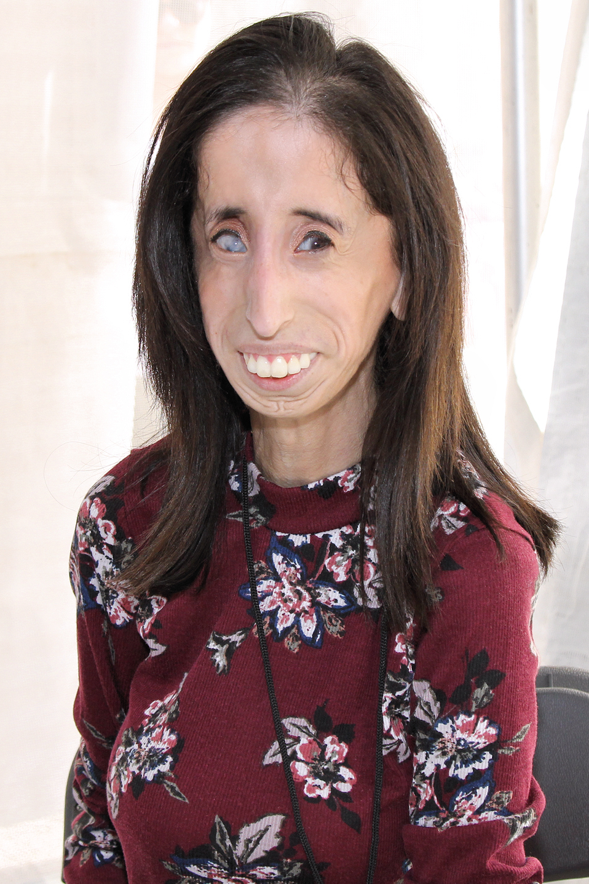
I always say that creating positive change in the world starts with just one person: you.
- Lizzie Velasquez
Lizzie Velasquez was born with a rare genetic condition which means that she cannot put on any weight, and is visually impaired. At school, she was bullied for looking different and, when she was 17, she found a video online which described her as the ‘world’s ugliest woman.’ The clip attracted 4 million views and lots of negative comments. Although these comments were really hurtful, she decided to take positive action. She used this experience and life story to become a highly successful motivational speaker, an anti-bullying activist and a YouTube star. She has described her family as a huge support network and said that her faith also gives her strength.
What virtues has Lizzie shown? What has helped her? What can we learn from her?
Image: wikimedia.commons.org

Slide 5
If you or someone you know is being cyberbullied, where can you go for advice? What can you do?
Draw around your hand and write down one place on each finger that you could go to for help.
Image: so.wikimedia.org

