Slide 1
Where is my local community?

Slide 2
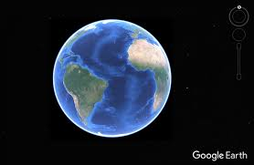
Use: https://www.google.co.uk/intl/en_uk/earth/ [accessed 26.05.2020] to find your local community.
Image: commons.wikipedia.org

Slide 3
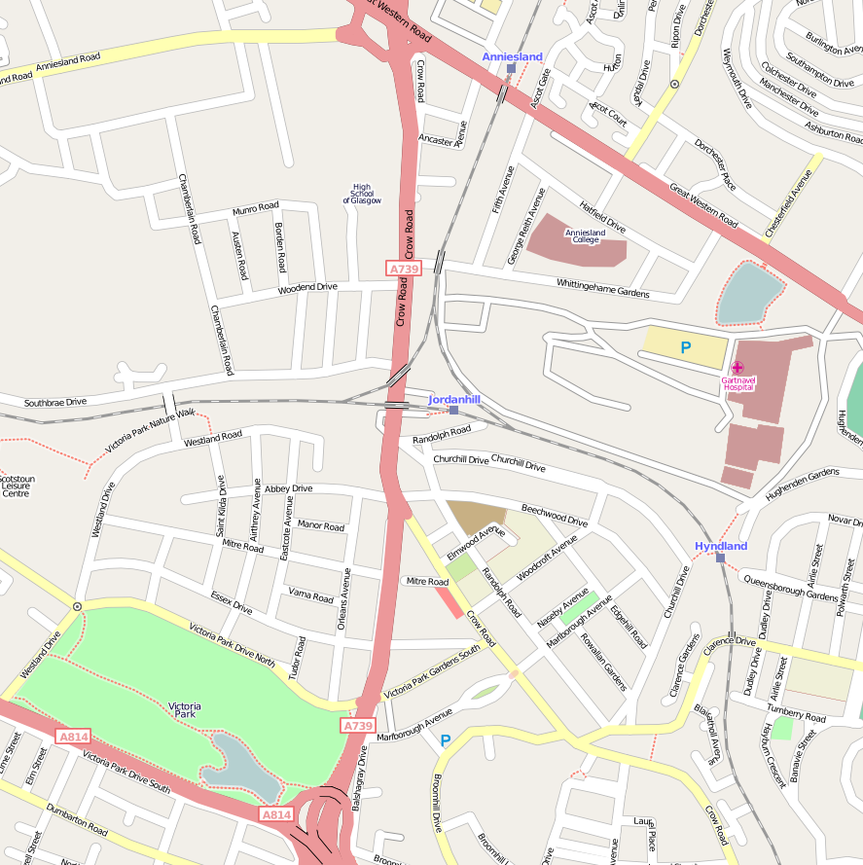
Use maps of your local area to find the key places and features of your community e.g. shops, parks, places of worship.. Which places do you use?
You might want to draw your own map of your local community, marking the places that are special to you.
Image: commons.wikipedia.org

Slide 4
Where do people provide a service in my local community? This could include bus drivers, bin men, shopkeepers etc.
Image: commons.wikipedia.org

Slide 5
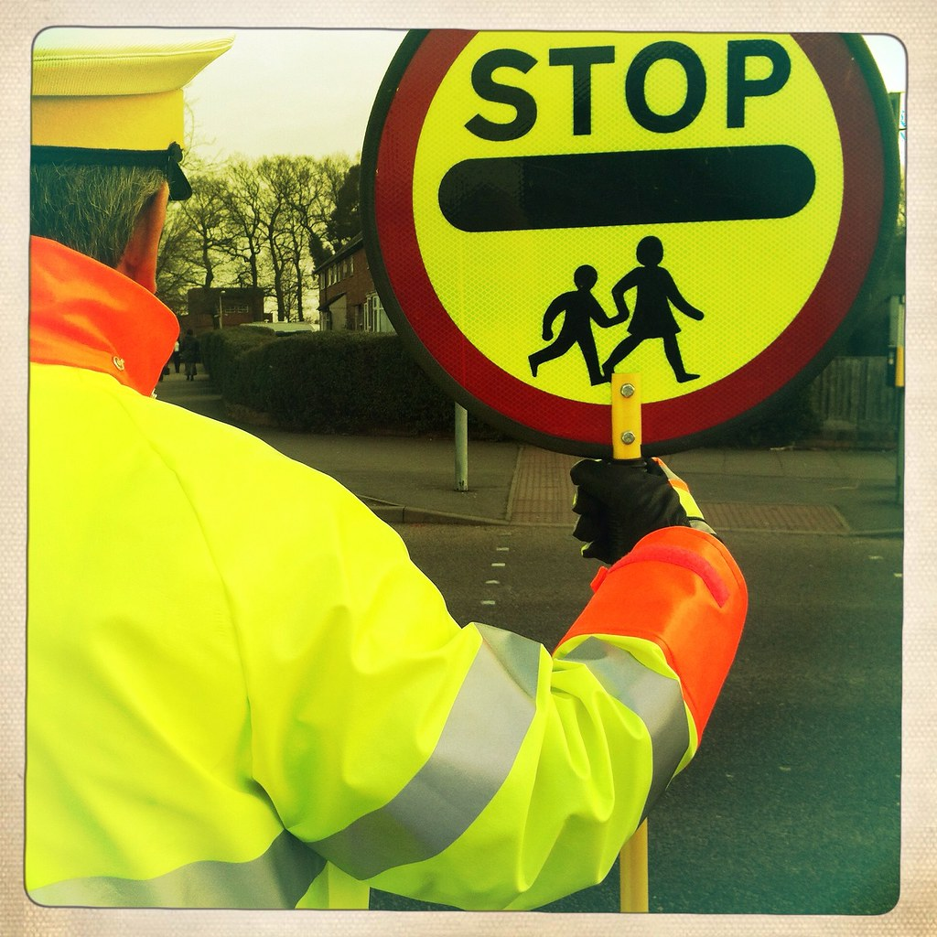
Choose one of the people who serve your community:
- What do they do for their community?
- What skills do they use? What virtues?
- How do they help us?
- How can we help them?
Image: flikr.com

Slide 6
How could you show gratitude to someone in your community this week?

