Slide 1
Image: pixabay.com
Image: flikr.com

Slide 2
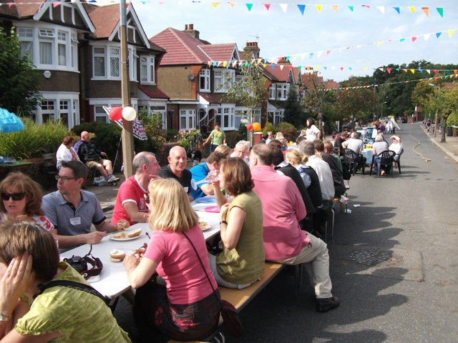
Image: geograph.org.uk
Image: commons.Wikimedia.org

