Slide 1
Teacher Training Workshop for Primary Trainees
Character and
Character Education in Schools
Notes:
These slides provide an introduction to the theory and practice of character education in schools from the Jubilee Centre for Character and Virtues at the University of Birmingham.

Slide 2
The Jubilee Centre For Character and Virtues
The work of the Centre seeks to help people understand and demonstrate the benefit that good character and virtues bring to the individual and society.
Notes:
The Jubilee Centre is a research centre based at the University of Birmingham, founded in 2012. It is the largest research centre in the world dedicated to moral character and virtues. It has informed the DfE, Ofsted and policy makers, such as the Secretary of State for Education. The Centre has established a distance-learning MA in Character Education (the first and only one in the world). It employs 25 people from a range of disciplines, including psychology, education and philosophy. It conducts world-leading research and developmental work, with young people (at all school levels) and professionals. It has an international impact in over 25 countries and has worked with teachers and government ministers in these countries, as well as regional UNICEF programmes.

Slide 3
The Purpose of Education
Education should aim to form people so they can live well in a world worth living in.
Notes:
Education is more than just the inculcation of knowledge. As teachers, we have greater moral responsibility than many other professionals. Teachers can be thought of as in loco parentis (in place of the parent).

Slide 4
Aims of Education
Every child can be taught
Educational institutions cannot turn out fully educated human beings
Schooling does not complete our education
Only through the trials of life can someone be fully educated
Notes:
Education is more than just the inculcation of knowledge. As teachers, we have greater moral responsibility than many other professionals. Teachers can be thought of as in loco parentis (in place of the parent).

Slide 5
Aims of Education
Character is not a simple concept, but rather a very complex aggregate of ideas, deeds, tendencies, and habits and this aggregate varies with each individual.
Notes:
Education is more than just the inculcation of knowledge. As teachers, we have greater moral responsibility than many other professionals. Teachers can be thought of as in loco parentis (in place of the parent).

Slide 6
Aims of Education
Some say education is exclusively about academic knowledge
Others say that character in schools should simply be about telling children what is right and incentivising them to do the right thing
Both are wrong
Notes:
Education is more than just the inculcation of knowledge. As teachers, we have greater moral responsibility than many other professionals. Teachers can be thought of as in loco parentis (in place of the parent).

Slide 7
Aims of Education
Education is not about information – it is about transformation
The test is not what a student knows – they will forget that in five years – the test is who a student has become in the process of education
Notes:
Education is more than just the inculcation of knowledge. As teachers, we have greater moral responsibility than many other professionals. Teachers can be thought of as in loco parentis (in place of the parent).

Slide 8
Questions
Notes:
Remind trainees to record any questions they have throughout the workshop – to be addressed during or following the workshop (they can also be addressed in follow-up seminar sessions).

Slide 9
What is Character Education?
Character is a set of personal traits or dispositions that evoke specific emotions, inform motivation and guide conduct.
Character education is an umbrella term for all explicit and implicit educational activities that help young people develop positive personal traits called virtues.
Notes:
Virtues – the Jubilee Centre uses the language of ‘virtues’, but these are often referred to as values, traits, dispositions or character strengths within schools. The term virtue in this definition does not carry a religious association; it refers to ‘good’, ‘goodness’, what is ‘right’, ‘morality’ etc. Similarly character education is often referred to as to moral education.

Slide 10
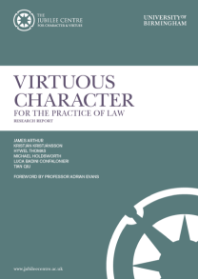
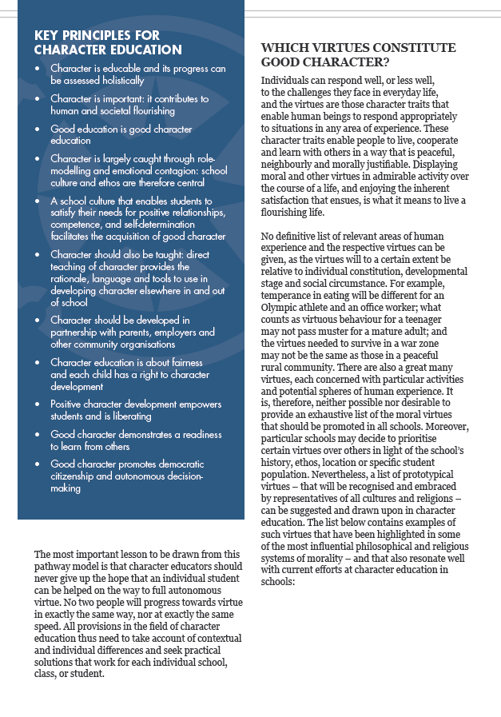
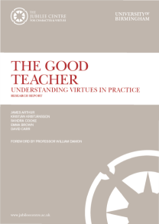
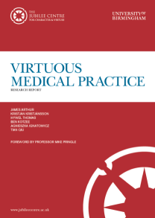
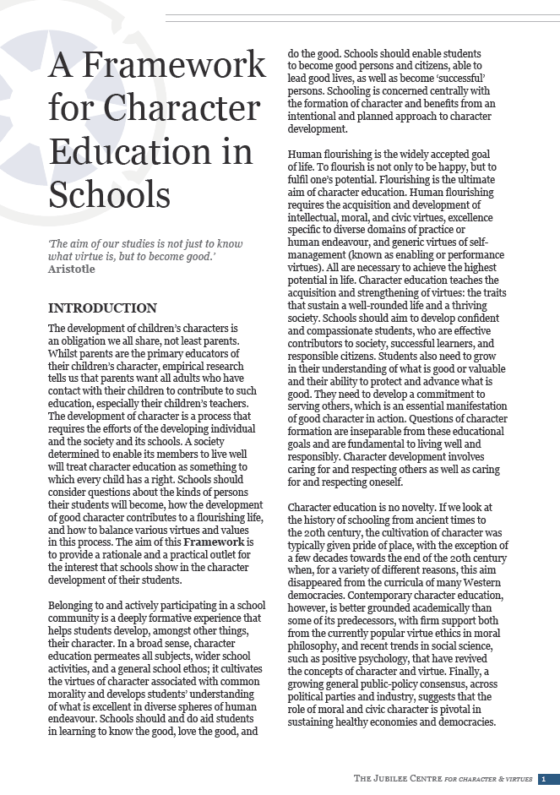
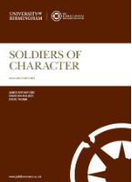
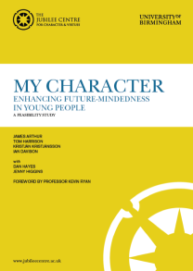
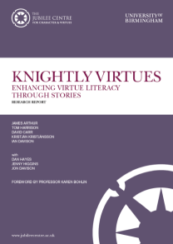
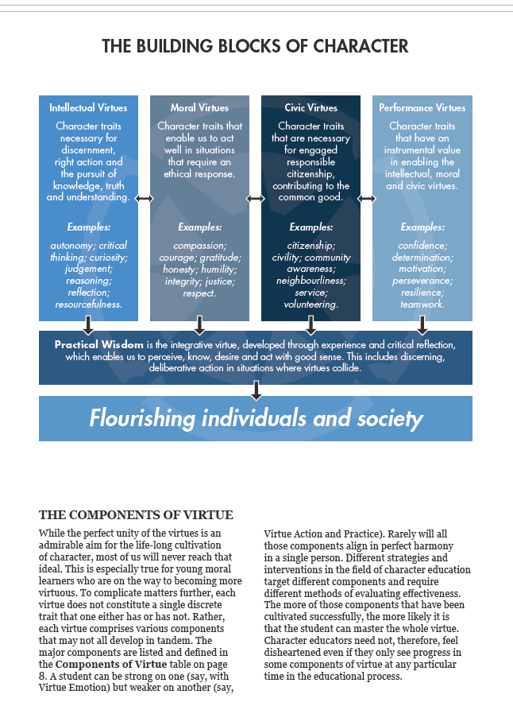
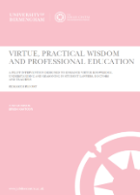
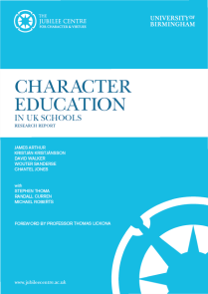
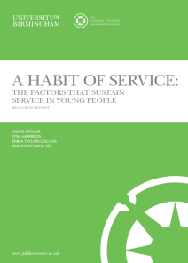
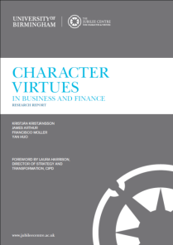
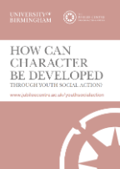
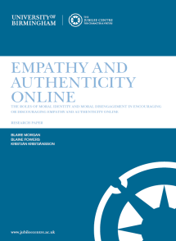
A Framework for Character Education in Schools (2017)
Centre Reports:
Notes:
The Jubilee Centre’s A Framework for Character Education in Schools (2017) follows a neo-Aristotelian approach to character education (for more information on this approach look at the further reading section) and is available to download for free on the Jubilee Centre’s website. It has been sent to every secondary school in the country and 4,500 primary schools. It explains the key principles of character education and has been adopted around the world. Research has also been conducted within the professions of nursing, business, law and the army, as well as with marginalised young people. The reports are also available to download for free on the Jubilee Centre’s website.

Slide 11
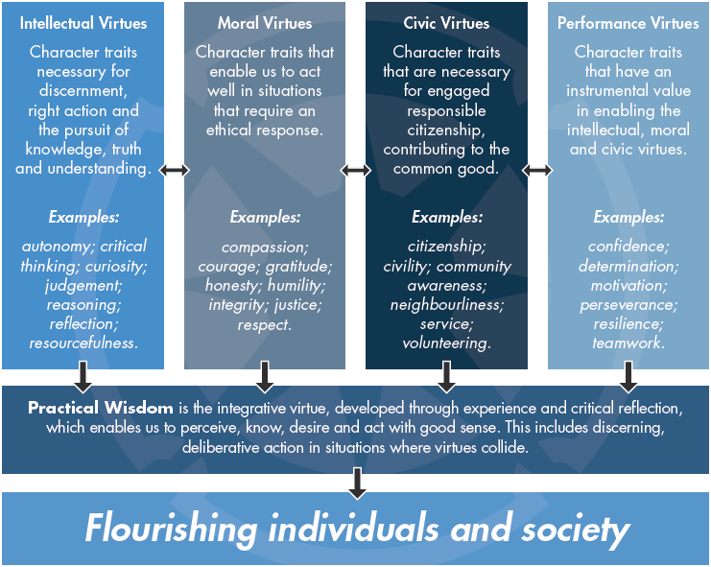
Notes:
Individuals can respond well, or less well, to the challenges they face in everyday life, and the virtues are those character traits that enable human beings to respond appropriately to a range of situations. These character traits enable people to live, cooperate and learn with others in a way that is peaceful, neighbourly and morally justifiable.
Character education teaches the acquisition and strengthening of virtues: the traits that sustain a well-rounded life and a thriving society. Human flourishing requires the acquisition and development of intellectual, moral, and civic virtues, as well as performance virtues (these make up the Building Blocks of Character).
No definitive list of virtues can be given, as the virtues will (to a certain extent) be relative to individual constitution, developmental stage and social circumstance. Although virtues can be divided up into different categories, they form a coherent, mutually supportive whole in a well-rounded life, and character education is all about their integration, guided by the overarching intellectual virtue of practical wisdom or ‘good sense’ (discussed on slide 16).

Slide 12
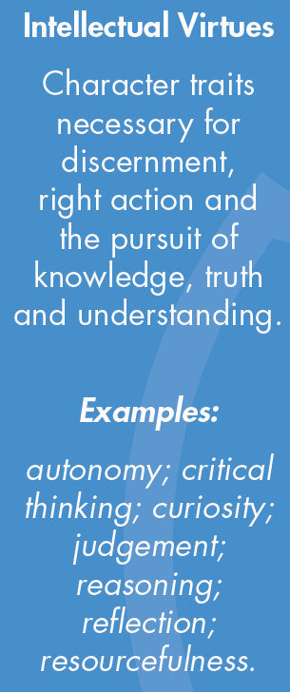
Notes:
All developing human beings will need to possess a host of intellectual virtues, such as curiosity and critical thinking, which guide their quest for knowledge and information. Among the intellectual virtues, one deserves a special mention. That is the virtue which the ancient Greeks called phronesis, which will be discussed on slide 16. It would be useful here to provide examples of intellectual virtues within the context of teaching/the classroom.

Slide 13
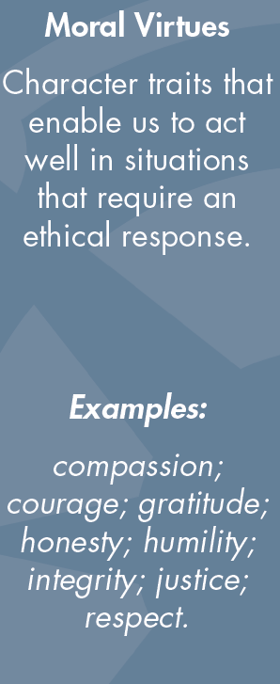
Notes:
It is not possible to provide an exhaustive list of the moral virtues that should be promoted in all schools. Moreover, schools may decide to prioritise certain virtues over others in light of the school’s history, ethos, location or specific student population. Moral virtues hold a specific role within character, whereby they have a bearing on other types of virtues, ensuring they serve morally respectable ends.

Slide 14
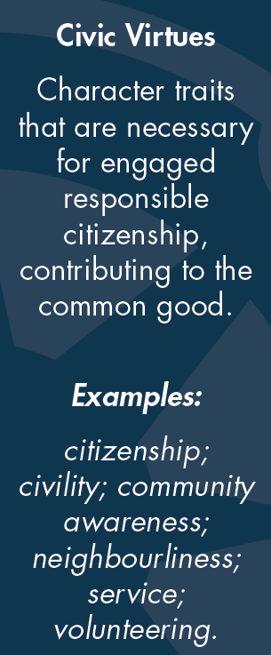
Notes:
Schools need to promote specific civic virtues, such as civility, service, citizenship, and volunteering, which help students understand their ties to society and their responsibilities within it.

Slide 15
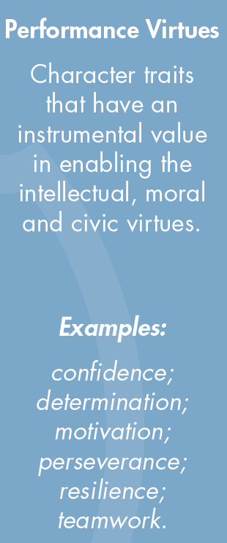
Notes:
All human beings need personal traits that enable them to manage their lives effectively. These traits are sometimes called performance virtues, or ‘enabling virtues’, to distinguish them from the specifically moral ones. All good programmes of character education will include the cultivation of performance virtues, but they will also explain to students that those virtues derive their ultimate value from serving morally acceptable ends, in particular from being enablers and vehicles of the intellectual, moral and civic virtues.
Resilience is commonly promoted in schools; however, when focused on it must be made clear that the performance virtues are ‘good’ if employed in a way that is morally ‘right’ – a gang member can show resilience, confidence or determination.

Slide 16
Phronesis
“Good sense”
Practical Wisdom is the integrative virtue, developed through experience and critical reflection, which enables us to perceive, know, desire and act with good sense. This includes discerning, deliberative action in situations where virtues collide.
Notes:
Phronesis is an intellectual virtue which can also be called practical wisdom, or ‘good sense’. It is often described to pupils as ‘good sense’ – doing the ‘right’ thing, for the ‘right’ reason, in the ‘right’ amount at the ‘right’ time. Aristotle refers to phronesis as enabling us to find the ‘golden mean’ between excess and deficiency of the virtues. It requires careful deliberation and judgement. The ability to learn from experience (and to make mistakes) is at the centre of it.
This is an important virtue for teachers when tackling ethical or moral dilemmas within in the profession (see slide 17/18). It is also important for pupils as they also face dilemmas e.g. between loyalty to friends and honesty to the teacher.

Slide 17
“Good sense” in Teaching
Can you think of any school-based scenarios where there may be a virtue conflict? (either for pupils or for teachers)
This could also be where school rules conflict with your own personal values.
Notes:
Take suggestions and discuss examples (an example dilemma is provided on the next slide).

Slide 18
Dilemma 1
You are a newly qualified teacher, teaching your Year Two class one winter’s day. There are three children in the class who have recently arrived in the UK. These three children have been fairly quiet and withdrawn in class, and you have been trying your best to engage them and encourage their interaction with their peers.
While there are no strict rules about staying in the classroom during lesson time, you’ve heard that your headteacher disapproves of this. Snow begins to fall outside and all of the children become excited. One of the recent arrivals, who has never seen snow before, asks: “Can we please go outside and touch it?”
What is in conflict here?
What would you do?
Notes:
What virtues/values are in conflict here? Discuss together and take suggestions.

Slide 19
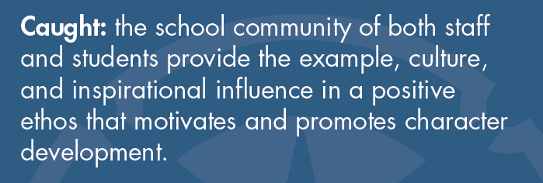
Character is…
Notes:
There is no blueprint or magic formula for delivering character education. Character ‘caught’ is the implicit side of character education. It is displayed in the school’s ethos/culture which teachers are expected to embrace. It can be seen throughout the curriculum, in all subjects and is often visible outside the curriculum e.g. assembly, volunteering, playtime, clubs.
Character ‘caught’ also focuses on the individual teacher’s character.

Slide 20
Do you remember any of your school teachers?
Why did you want to become a teacher?
Notes:
Research has shown that adults remember their teachers because of their character; both positive and negative. This is an opportunity to provide examples of teachers from your past and why you wanted to become an educator – trainees may also wish to share their motivations.
Emphasise that teachers often enter the profession for moral reasons and motivations (for example to help children learn, to impact their lives, to ‘give something back’ and to develop good people). This links to character education because character education is about enabling children to flourish as individuals and within society.

Slide 21
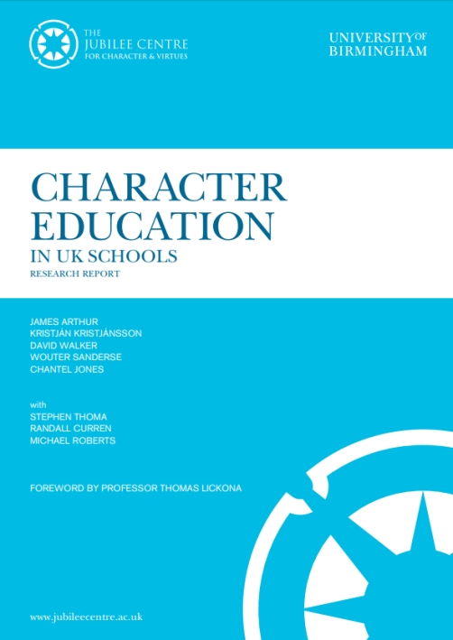
Character Education in UK Schools (2015)
84% of UK parents believe that teachers should encourage good morals and values in their students
91% of UK adults surveyed said that it is important that schools help children develop good character
Only 33% of teachers stated that they had specific or additional training in moral or character education, yet 60% were required to teach a related subject
Only 24% of primary school teachers believed ITE had prepared them very well to explore and develop moral issues
Notes:
The Jubilee Centre’s Report Character Education in UK Schools identifies teachers’ and parents’ perceptions of character education. The final statistic emphasises the need for ITE providers and schools to discuss and work on these areas with trainees.

Slide 22
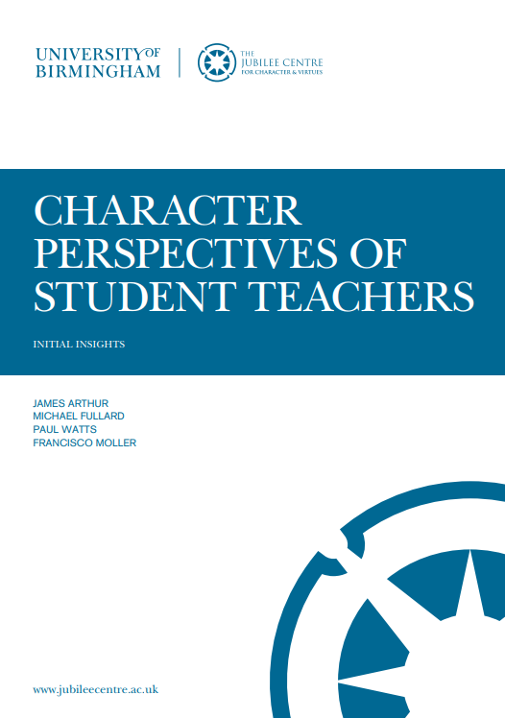
What do Trainee Teachers Think? (2018)
87% of trainee teachers acknowledged the inherent role that character plays in their own professional development
91% recognised the importance of character as a factor in the academic achievement of pupils
At the beginning of ITE, only 24% of trainee teachers felt ‘very prepared’ or ‘prepared’ to develop the character of their pupils
…This increased to 67% following ITE and training on character education
Notes:
This report is based on research conducted with trainee teachers in 2018.

Slide 23
Teachers as ‘Role Models’
Most teachers enter the profession as a result of a moral motivation such as desire to positively impact on the lives of young people
Character Education in UK Schools (2015)
99% of teachers consider themselves to be ‘a moral role model’
The Good Teacher (2015)
As teachers inevitably serve as role models within the classroom and beyond, it is reasonable to consider the character of the ‘good’ teacher and to understand what kind of person makes that kind of teacher
Notes:
These are examples illustrating the importance of character and character education within publications.

Slide 24
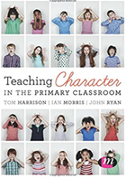
Teachers as ‘Role Models’
The Moral Work of Teaching: A virtue-ethics approach to teacher education (Cooke, 2017)
‘…whether teachers acknowledge their role as an exemplar or not, young people in their care will learn from their manner, behaviour, attitudes and dispositions’
Teaching Character in the Primary Classroom (Harrison et al., 2016)
‘Primary school teachers are emphasising and reinforcing moral virtues every day – whether this is done implicitly or explicitly’
Notes:
These are examples illustrating the importance of character and character education within publications.

Slide 25
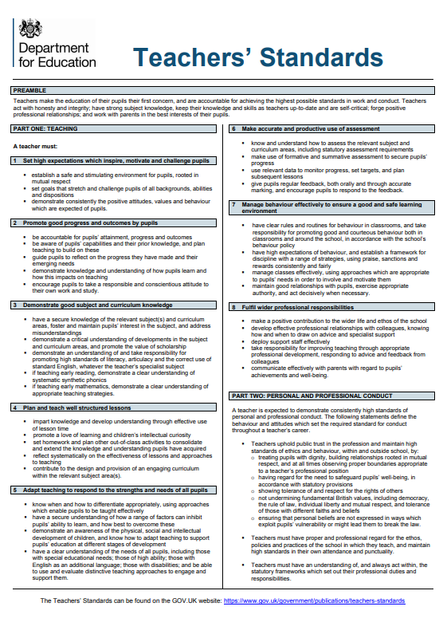
How do the Teachers’ Standards relate to character?
Preamble: ‘Teachers act with honesty and integrity’
A teacher must:
Demonstrate consistently the positive attitudes, values and behaviours which are expected of pupils.
Promote a love of learning and children’s intellectual curiosity.
Maintain good relationships with pupils, exercise appropriate authority, and act decisively when necessary.
Notes:
Teachers may be the first positive role model a pupil has. They are role models at all times – children pick up on tone, attitude, body language, eye contact etc. This slide provides a snapshot of how the character of the teacher is addressed within the Teachers’ Standards. The Teachers’ Standards require high standard of ethics – dignity, respect, tolerance; to meet these, they must set high standards, be consistent, use good sense (phronesis), and be aware of moral/ethical dilemmas that occur within teaching.

Slide 26
My Character and its Importance
Resourcefulness (intellectual) – the ability to alter a lesson based on the children’s understanding or needs
Compassion (moral) – dealing with children going through difficult situations in their home lives
Volunteering (civic) – giving up your own time to support a child to understand a concept
Resilience (performance) – seeking advice and support instead of giving up after a poor lesson observation
Notes:
These are examples of how different virtues can be demonstrated by a teacher and their importance within the profession. Other examples can be provided – this opens up a good opportunity for discussion at different stages of a trainee teacher’s training.

Slide 27
Dilemma 2
You are coming to the end of your first year as an Early Years teacher. The school has been under pressure to show more progress in attainment across the school, from EYFS to KS2. This year, your friend and colleague in Year 1 has struggled to show much progress in pupil attainment, and feels that this is because pupils came to them with ‘exaggerated’ scores. They are worried that this will affect their chance of a promotion.
You are just about to submit your end of year data when your headteacher asks for a meeting and encourages you to “be more generous” with the data by changing some of the levels of development from ‘emerging’ to ‘expected’ and some from ‘expected’ to ‘exceeding’. You are concerned that this data, while making you look good, does not reflect the ability of the children and will put more pressure on your colleague next year.
What is in conflict here?
What would you do?
Notes:
Another ethical dilemma for discussion.

Slide 28
Character Education in School
What might this look like?
How and when do you think character education might feature:
Within the school day?
Within the classroom?
Outside of the classroom?
Notes:
We now turn to how character education can be ‘taught’ in school – this overlaps with how it can be ‘caught’ – the two are not mutually exclusive, but mutually supportive. How do the trainees think character can be caught/taught in the school? (besides through the teacher’s role-modelling).

Slide 29
Character is…
Notes:
There is no magic blueprint for a ‘taught’ approach. To develop knowledge and understanding we need a deliberate curriculum that supports and is supported by caught character education. This helps pupils to understand virtue terms, what they mean and what they ‘look like’ in real life. ‘Taught’ character education is planned for and deliberate. Teachers and staff are conscious of how what they teach contributes to character development. This can be inside and outside of the classroom.

Slide 30
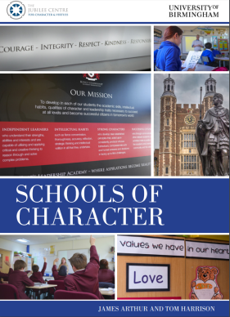
Character Education in Schools
Not just a focus on resilience or ‘grit’
Character education is integrated within the school environment and curriculum
Notes:
As will be understood from the previous slides, character education isn’t just about ‘grit’. Some schools and research publications seem to focus solely on performance virtues. Character education is about the school environment and curriculum. Indeed, many schools have particular virtues which they prioritise over others in light of the school’s history, ethos, location or specific student population.

Slide 31
Character Education in Lessons
Schools of Virtue Report (2017):
‘In developing a vision for character education schools should be aware of how each activity relating to character education will enhance the development of the components of virtue literacy…’
Children are taught about the qualities of virtuous character through standalone activities or through the incorporation of character education within subjects
Character education is a conscious part of the school day
Notes:
The Schools of Virtue report, which presents research from 3 schools in which character education is a central part of their ethos and programme of education, provides details on how schools can teach character and foster it within their curriculum, as well as within their school culture.
Character education can be part of a lesson aim/objective/outcome – it does not have to be the sole focus. Virtues can be taught about explicitly, for example in assemblies, through discussing moral dilemmas, or reflecting upon the actions of famous/historical figures. Reflection time for pupils on the virtues is extremely important, for example when discussing the actions of historical figures/events from history, pupils should be guided in reflection to consider how this is relevant to them, what lessons can be learned, how it relates to their own lives etc.
Character education is cross curricular. For example, virtues can be taught in subject lessons (e.g. perseverance when tackling new concepts in maths; compassion in science when thinking about animal testing/product development; community awareness in history; humility and honesty of characters in stories within English etc.)

Slide 32
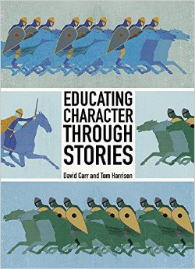
Character Education through Stories
A significant amount of the school day incorporates reading and literature; therefore the integration of character education has much potential
Helterbran (2009)
Historically, stories have been used to convey moral messages to their audiences, illustrating the negative and positive consequences of vice and virtue, respectively
Notes:
Stories can be used as a vehicle for teaching character – historically, stories (e.g. fables) have been used to teach moral messages to children. Many of the stories used within schools today are also very useful for this. An important part of this process is making the story context relevant for the pupils. For example, when reflecting on a character’s actions or decisions, pupils can be asked about whether they have faced similar situations, what they would have done in the same situation and whether it was ‘right’ for that to happen. Contrasting views can be explored and discussed.

Slide 33
Character Education through Stories
Stories are used across the curriculum and often as the basis for topic planning.
They Can be Used:
to inform discussion
for targeted questioning
Do you think it was right for..?
Year 5/6 Examples
Why do you think..?
In what way could..?
for personal reflection – helping to understand context
Notes:
Stories can be used as a vehicle for teaching character – historically, stories (e.g. fables) have been used to teach moral messages to children. Many of the stories used within schools today are also very useful for this. An important part of this process is making the story context relevant for the pupils. For example, when reflecting on a character’s actions or decisions, pupils can be asked about whether they have faced similar situations, what they would have done in the same situation and whether it was ‘right’ for that to happen. Contrasting views can be explored and discussed.

Slide 34
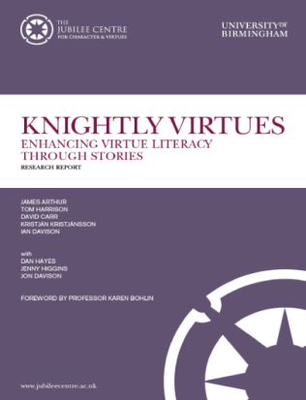
The Knightly Virtues
Literature-based character education programme designed to help teach moral character in schools
The Knightly Virtues resources significantly increased the ability of pupils to use and understand virtue language and concepts
Notes:
The Knightly Virtues Project resources are highly popular in schools, especially amongst year 5 and 6 pupils. The stories and activities facilitate the development of reading and writing skills as well as character education. They are engaging for pupils and have been found to be popular amongst reluctant readers. This programme was designed to help teach moral character in schools using high quality classic and real-life stories. Over 20,000 children have had access to these. Examples of stories include: The Merchant of Venice, Don Quixote, Beowulf, Gareth and Lynette, Anne Frank etc.
The Project shows how such stories can be used for the purpose of character education. All resources are available online from the Jubilee Centre’s website. Lesson plans are easily adaptable. They include teacher notes, lesson plans and pupil resources.

Slide 35
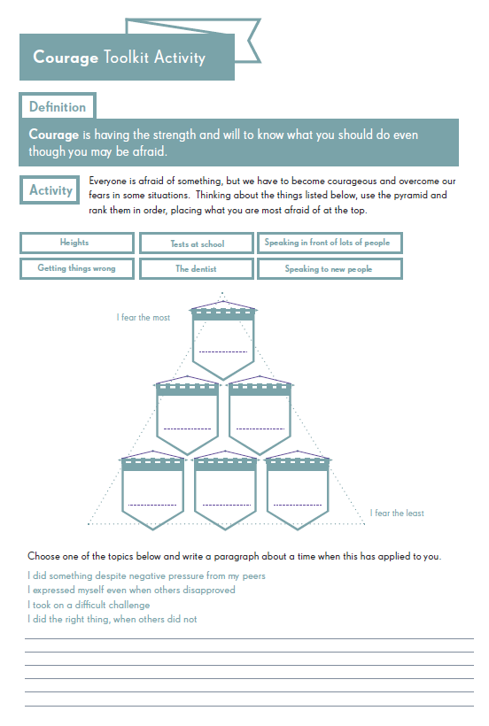
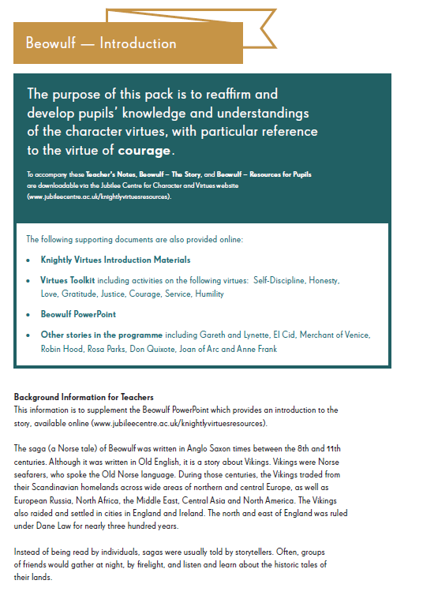
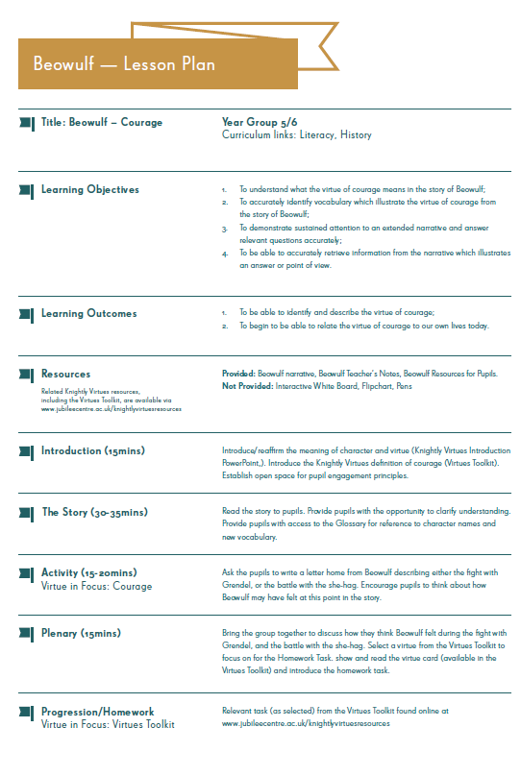
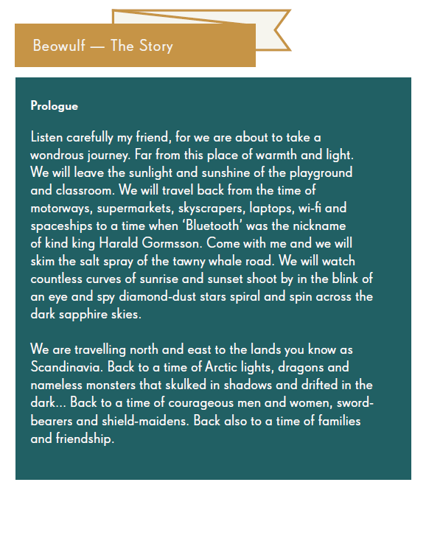
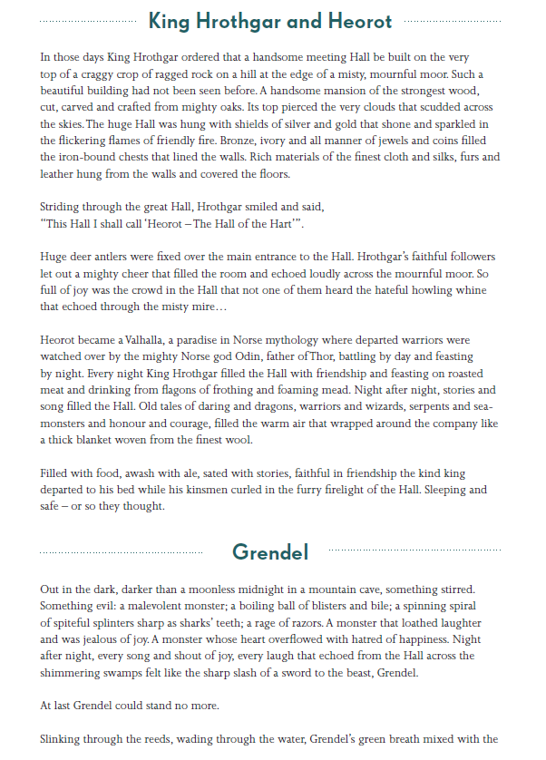
Notes:
The Knightly Virtues Project resources are highly popular in schools, especially amongst year 5 and 6 pupils. The stories and activities facilitate the development of reading and writing skills as well as character education. They are engaging for pupils and have been found to be popular amongst reluctant readers. This programme was designed to help teach moral character in schools using high quality classic and real-life stories. Over 20,000 children have had access to these. Examples of stories include: The Merchant of Venice, Don Quixote, Beowulf, Gareth and Lynette, Anne Frank etc.
The Project shows how such stories can be used for the purpose of character education. All resources are available online from the Jubilee Centre’s website. Lesson plans are easily adaptable. They include teacher notes, lesson plans and pupil resources.

Slide 36
In the Classroom
Why are resources like the Knightly Virtues useful in the classroom and how are they applicable?
High-quality Resources
Engaging
Multiple Uses
High-level Vocabulary
Increases Understanding of Virtue Terms
Notes:
The Knightly Virtues Project resources are highly popular in schools, especially amongst year 5 and 6 pupils. The stories and activities facilitate the development of reading and writing skills as well as character education. They are engaging for pupils and have been found to be popular amongst reluctant readers. This programme was designed to help teach moral character in schools using high quality classic and real-life stories. Over 20,000 children have had access to these. Examples of stories include: The Merchant of Venice, Don Quixote, Beowulf, Gareth and Lynette, Anne Frank etc.
The Project shows how such stories can be used for the purpose of character education. All resources are available online from the Jubilee Centre’s website. Lesson plans are easily adaptable. They include teacher notes, lesson plans and pupil resources.

Slide 37
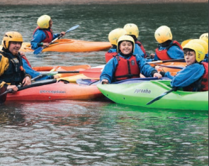
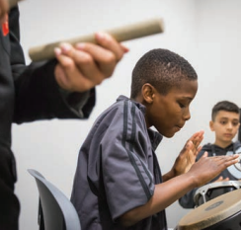
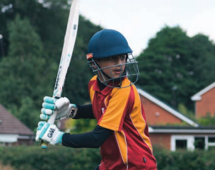
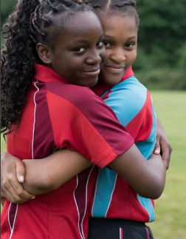
Character Education through Enrichment
Social action
Interaction with the local community
A variety of sports activities and clubs
How could you contribute to this?
Notes:
Character education occurs in and out of the classroom – it also includes extra-curricular activities/enrichment activities. Providing a safe place to practise the virtues in a new context helps to make the link between what is learnt and what is put into practice (these activities help to bridge the gap). Many schools refer to this as ‘enrichment’. Reflection question for trainees – how are you/could you contribute to this at your school, e.g. running clubs etc.?

Slide 38
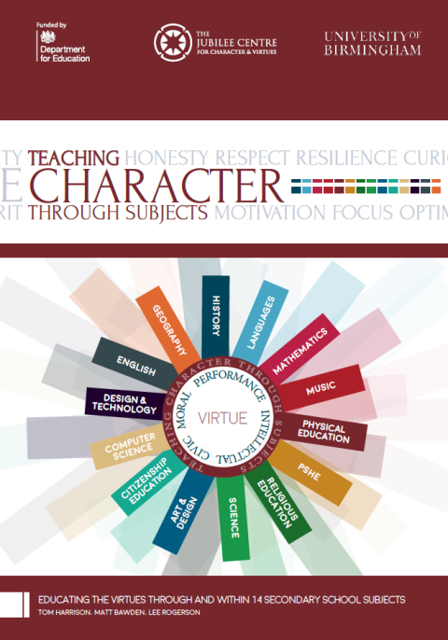
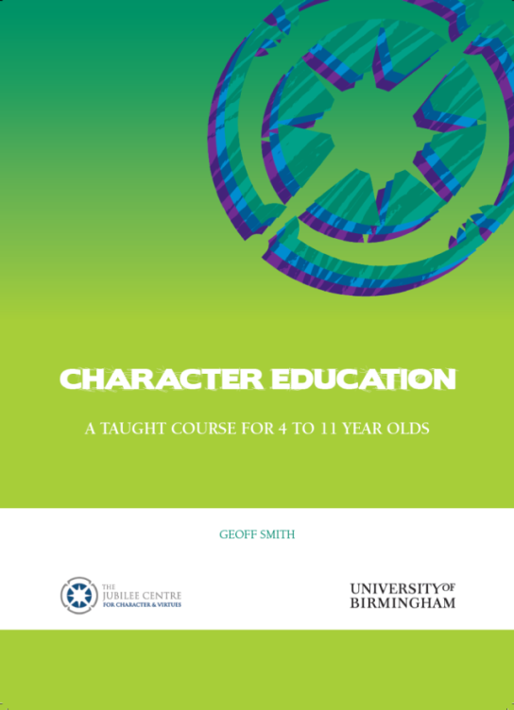
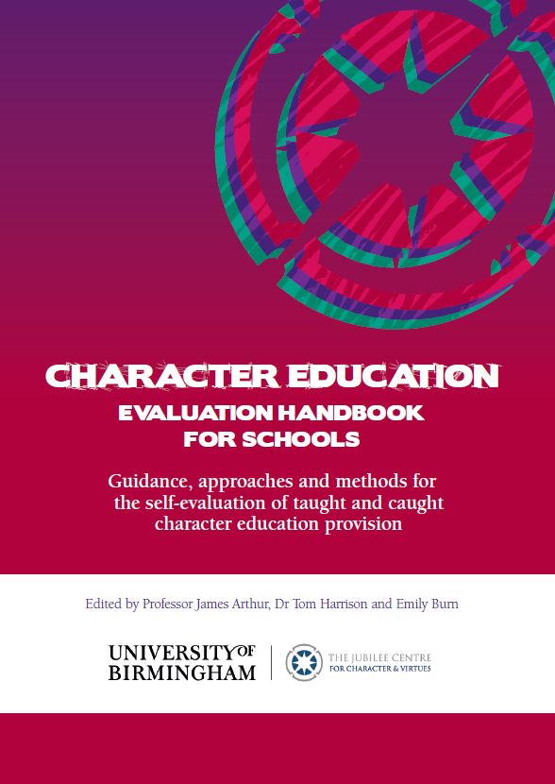
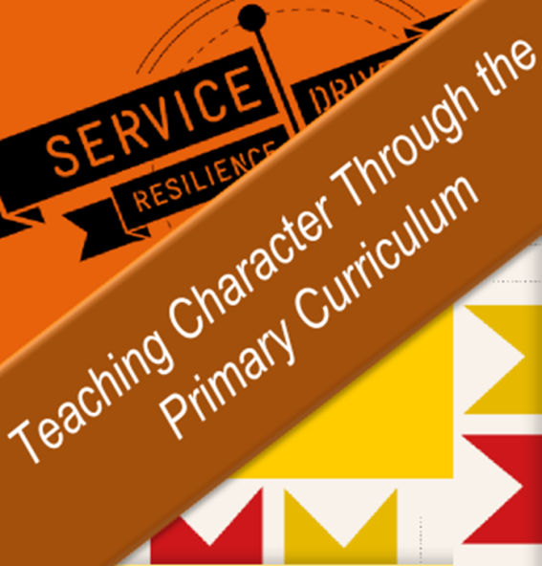
Resources
Notes:
There are a range of free resources available online via the Jubilee Centre’s website or app. The resources have been designed by teachers and experts in the field. All have been trialed in schools and have been evaluated and edited based on teacher/pupil feedback. Lesson plans, presentations and resources are provided, e.g. The Knightly Virtues, Teaching Character Through the Primary Curriculum (uses moral exemplars to explore virtues), Character Education: A Taught Course for 4 to 11 year olds.
The Jubilee Centre does not aim to be prescriptive. In producing these resources, it is expected that teachers ‘dip into’ different parts and adapt these as necessary. Quite often, they are used as inspiration for teachers’ own lessons.

Slide 39
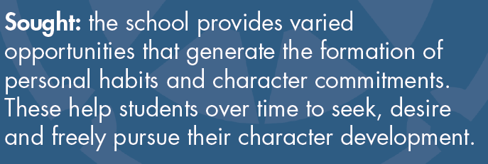
Character is…
Notes:
Finally, one of the aims of character education should be that pupils actively and autonomously seek to develop their character and virtues. This involves the provision of opportunities for pupils to actively seek to develop their own character (for example through ‘play leaders’ and opportunities to engage with and support the local community).

Slide 40
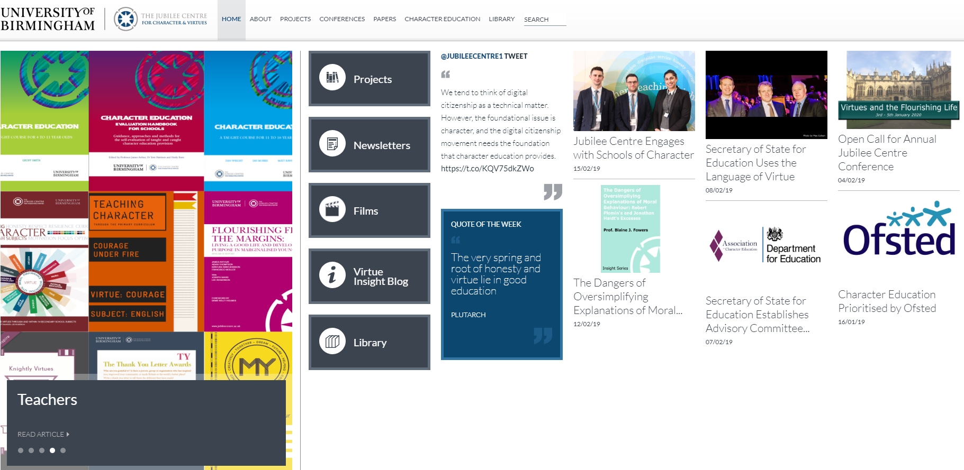
Website
Notes:
https://www.jubileecentre.ac.uk/ Through the website, trainees can access the Jubilee Centre blog and teaching resources (which are accessible via the website and free to download; hard copies of certain resources can be requested). The website contains the largest library of character/moral education texts. It also provides opportunities to get involved with research projects for individual teachers or schools. Anyone can sign up to the free monthly newsletter. Please encourage trainees to get in touch – contact details are on the website.

Slide 41
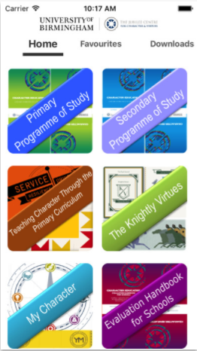
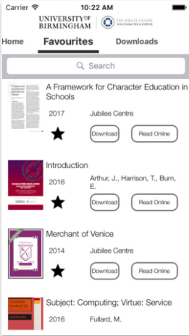
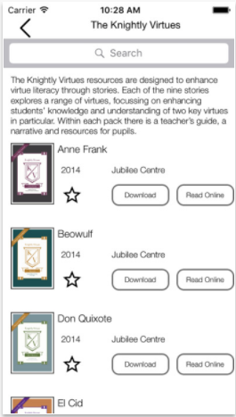
Mobile App
Notes:
The free app can be downloaded on Android and Apple via the App store. Search ‘The Jubilee Centre’ in ‘Education’.

